Slide 1
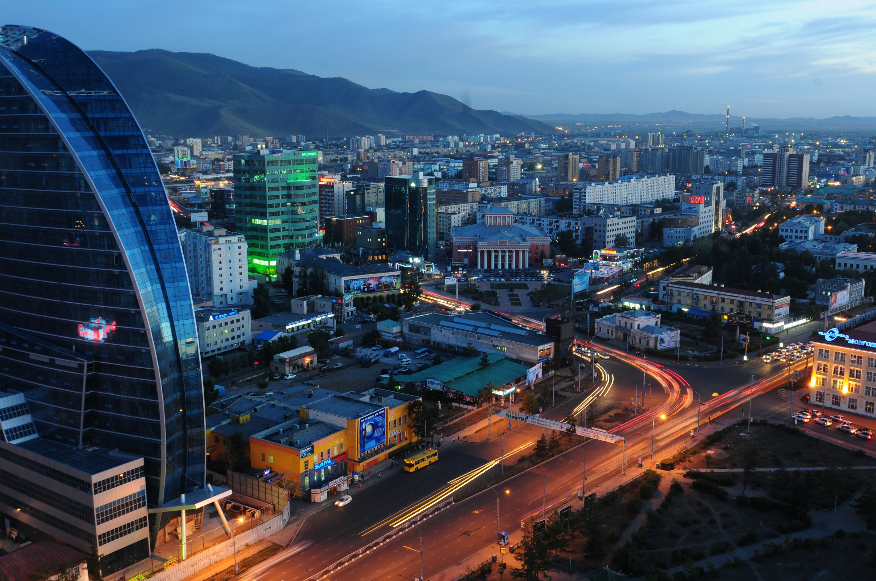
MIK HFC LLC
Resolving the affordability and informal housing challenge Case of Mongolia
Gantulga Badamkhatan
CEO of Mongolian Mortgage Corporation HFC

Slide 2
INFORMAL HOUSING IN MONGOLIA
Without affordable housing solutions and appropriate infrastructure investments, rapid urbanization has contributed to the rise of informal housing settlements on the outskirts of Ulaanbaatar, known as ger districts.
About 60% of Ulaanbaatar’s population, or 800,000 people, live in ger areas.¹
This is equivalent to approx. 209K households out of the 465K households in Ulaanbaatar, or 45% of households. ²
The Law on Allocation of Land to Mongolian Citizens for Ownership in 2002 has also led to the expansion of ger areas.
This law allows any Mongolian citizen to acquire and own land of approx. 700m2; the land may be used for residential, agricultural, or other purposes, yet many low-income citizens other without housing options decide to build gers on the property.

Slide 3
ULAANBAATAR: URBANIZATION
Over the last three decades, Mongolia has experienced high levels of rural-to-urban migration.
A search for improved living conditions and better employment options has driven this massive rural-to-urban migration to Ulaanbaatar and the consequential increase in demand for housing.
Approx 20% of the population has migrated to Ulaanbaatar over the past three decades¹, and much of this migration has occurred without substantial build in affordable housing units for lower-income citizens.
As of 2021, Ulaanbaatar was home to 48% of the country’s population (approx. 1.38 million), and approx. 40,000 people migrate to Ulaanbaatar p.a. ²
Mongolia’s population has grown by 8.9% from 2017 to 2022 and is expected to reach 3.8 million by 2027, growing by 6.7% from 2023 to 2027.2
Mongolia has a higher level of population living in cities as compared to most peers, with 67.5% living in urban areas while comparable countries have an average urban population of 59.9%.³

Slide 4
INFORMAL HOUSING ALSO KNOWN AS GER DISTRICT
In Mongolia, informal housing settlements called “Ger districts”, name derived Mongolian dwellings called “ger”, which are circular structures made of felt and wood.
Key characteristics of ger districts:
spontaneously spread out, without formal planning. 197K households in 2013 increased to 209K in 2024.
Cluster of none/sub standard detached houses not connected to adequate infrastructure: paved roads, reliable water supply, and proper sanitation facilities.
Residents often face economic hardships, with limited job opportunities and low incomes.
Socio-economic impact of ger districts:
While they offer affordable housing and cultural benefits, they also present challenges in terms of living conditions and access to essential services. The traditional use of wood and coal for heating contributes to heavy air pollution, especially in winter (-30C)

Slide 5
SCALE OF THE CHALLENGE
Population
Households
Total: 3.5 million
Gender ratio: 49:51 (M:F)
Median age: 26.9
Age distribution:
0-18 37%
19-60 54%
60+ 8%
Total of 983.5K
Capital city 47% or 465K
Rest area 53% or 518K
Housing in UB (465K)
Formal housing 256K (55%)
Informal housing 209K (45%)
source: NSO, as end of 2023

Slide 6
RESOLVING AFFORDABILITY AND INFORMAL HOUSING
 | Causes | Solutions
Political | Poor policy coordination between Central and Municipal Governments | Vision 2050 Master Plan by PM SDG Ulaanbaatar City Master Plan
Economic | Poor city Infrastructure Investment constraints | Expansion of existing infrastructure to enable new settlements IFI funded projects + Private sector
Financial | Lack of Fund Household income level vs home price Access to mortgage loan | Government AHFP(2013) Establishment of SWF
Systemic | Weak banking sector Lack of formal housing finance system Value chain Green housing standard | Established secondary mortgage market Availability of mortgage products

Slide 7
AFFORDABLE HOUSING FINANCE PROGRAM (AHFP)
The Affordable Housing Finance Program is a mortgage subsidy program launched in 2013 by the BoM to provide low- and middle-income Mongolians with affordable mortgages and support formal homeownership.
Under the program, the BoM provided loans to commercial banks at a discounted 4.0% interest rate, enabling banks to on-lend to households at an interest rate of 8.0% for 20 years (in October 2020, these terms were changed to 6.0% and 30 years).
2013-2023 around 120K households have acquired mortgage loans through the program.
In Ulaanbaatar, households living in formal housing increased from 40.2% to 51.2% and,
About 40% of borrowers or 42,5k households transitioned from informal to formal houses.
Mortgage loan outstanding to GDP increased from 5.1% in 2012 to 10.9% 2023

Slide 8
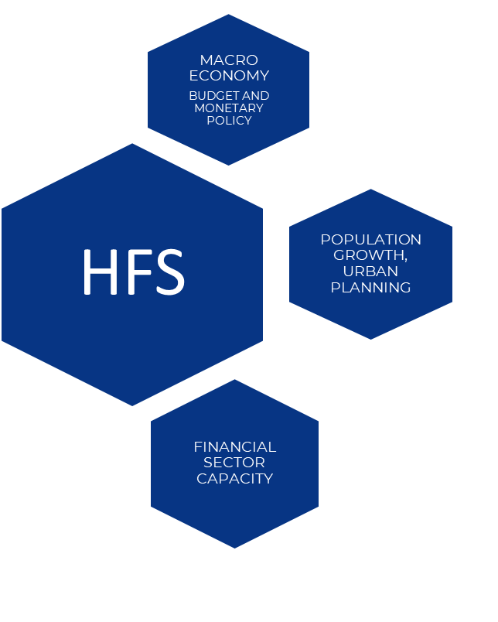
CHALLENGES | OPPORTUNITIES
Sustainability: Maintaining long-term affordability and accessibility for all income groups, while also ensuring that the financial institutions involved remain solvent and healthy. | Achieve SDGs: Housing finance is a powerful tool to achieve several SDGs, encapsulating economic, social, and environmental aspects.
Externality costs: The prevalence of informal housing leads to unaccounted-for environmental social and economic externalities, such as pollution and related health issues. | Reshape urbanization: HF can be used as a strategic tool to redesign urban areas, providing sustainable housing solutions and improving living conditions, thus transforming the cityscape and people’s informal dwelling conditions.
Short terms funds, high costs: Reliance on short-term funds can lead to high costs due to liquidity mismatches and increased mortgage rates, making it challenging for lower-income households to afford homes. | Long-term, sustainable investment: Creation of long-term, sustainable financial structures can foster a stable housing market. This includes developing new financial products that provide secure, long-term funding for housing while offering investors stable returns.

Slide 9
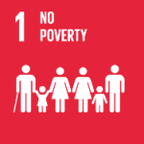
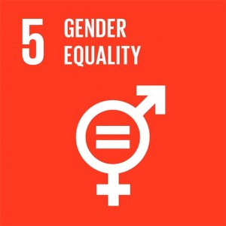
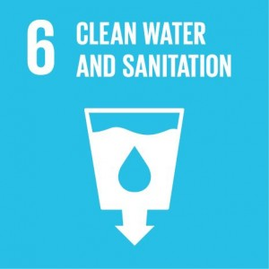
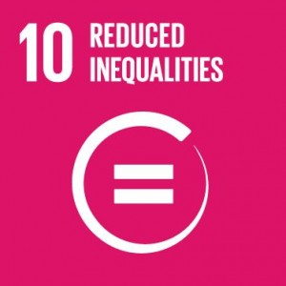
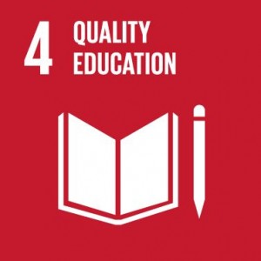
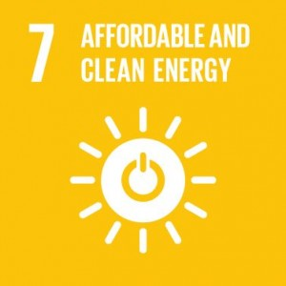
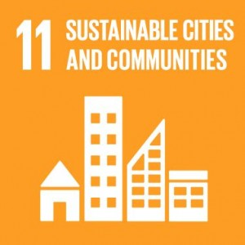
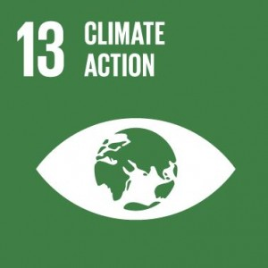
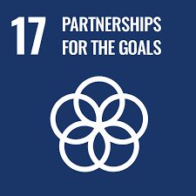
ACHIEVING SDG GOALS THROUGH REDEVELOPMENT
Well delevoped HF is important and is critical to the Mongolian economy.
HF is essential for the promotion of access to formal housing, ensuring a stable and robust financial system, enhancing access to educational and economic resources, and the improvement of the environment and overall quality of life in Mongolia, contributing to 12 of the SDGs.
Current ger district situation is result of shortage and lack of formal housing finance in the past.
INTEGRATED PART OF GOALS
DIRECT CONTRIBUTION TO GOALS
INDIRECT CONTRIBUTION TO GOALS

Slide 10
LESSONS LEARNT
Implement Targeted Financial Assistance Programs
Address the affordability gap for households in ger areas.
Provide subsidies or low-interest loans to support housing costs.
Enhance Public-Private Collaboration
Accelerate the transition of households to standardized housing units.
Foster partnerships for housing development projects.
Establish Comprehensive Infrastructure Development Plan
Improve living conditions in ger districts.
Develop essential services such as water, sanitation, and electricity.
Introduce Incentive Policies for Housing Improvement
Encourage the upgrade of existing houses and gers.
Ensure homes meet basic living standards.
Create Educational and Employment Initiatives
Tailor programs to the needs of residents in ger areas.
Promote sustainable livelihoods through skill development and job opportunities.

Slide 11
THANK YOU
Contact us
info@mik.mn
www.mik.mn

