Slide 1
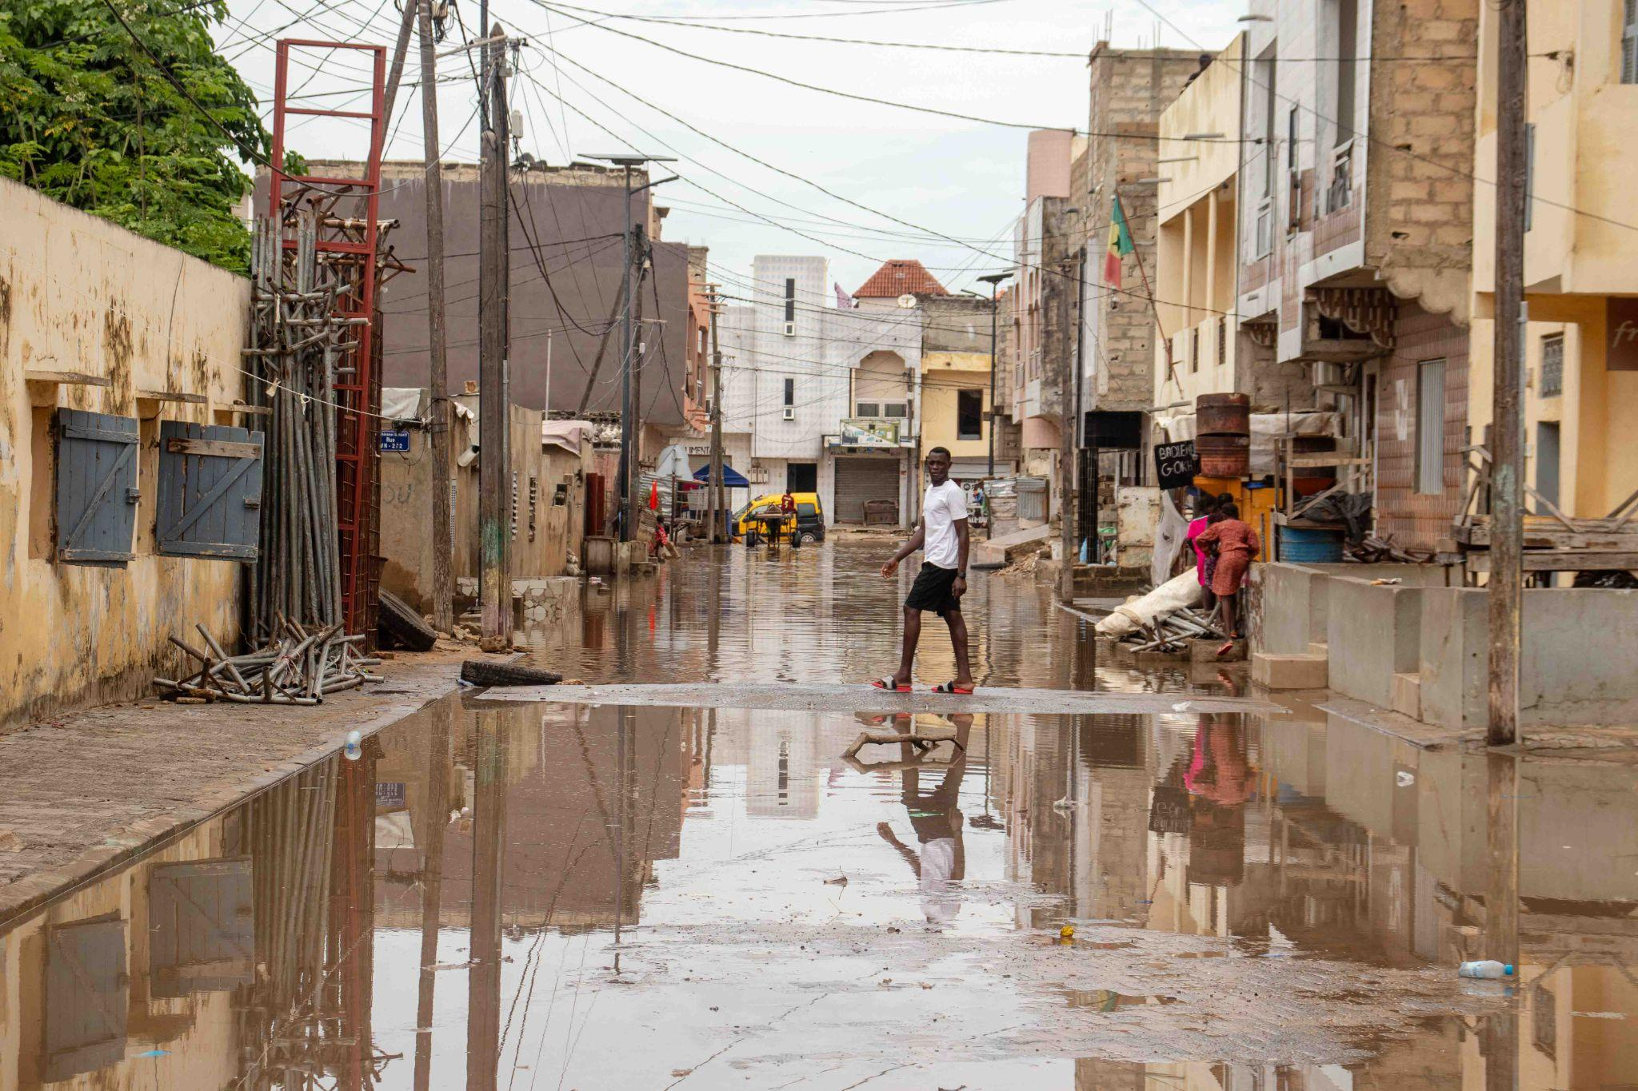
Community-based and
integrated flood risk management
in the suburbs of Dakar, Senegal
IUHF Congress, Berlin - 09/19/2024

Slide 2
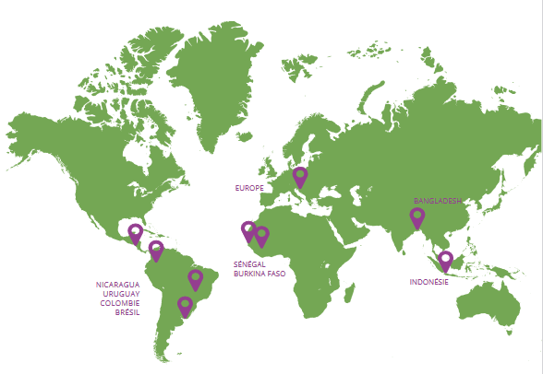
Franco-Swiss association committed to sustainable cities by and for their inhabitants
International cooperation and peer-to-peer exchanges of experiences.
Technical support to projects.
Promotion of financing tools and mechanisms for community-led housing solutions.

Slide 3
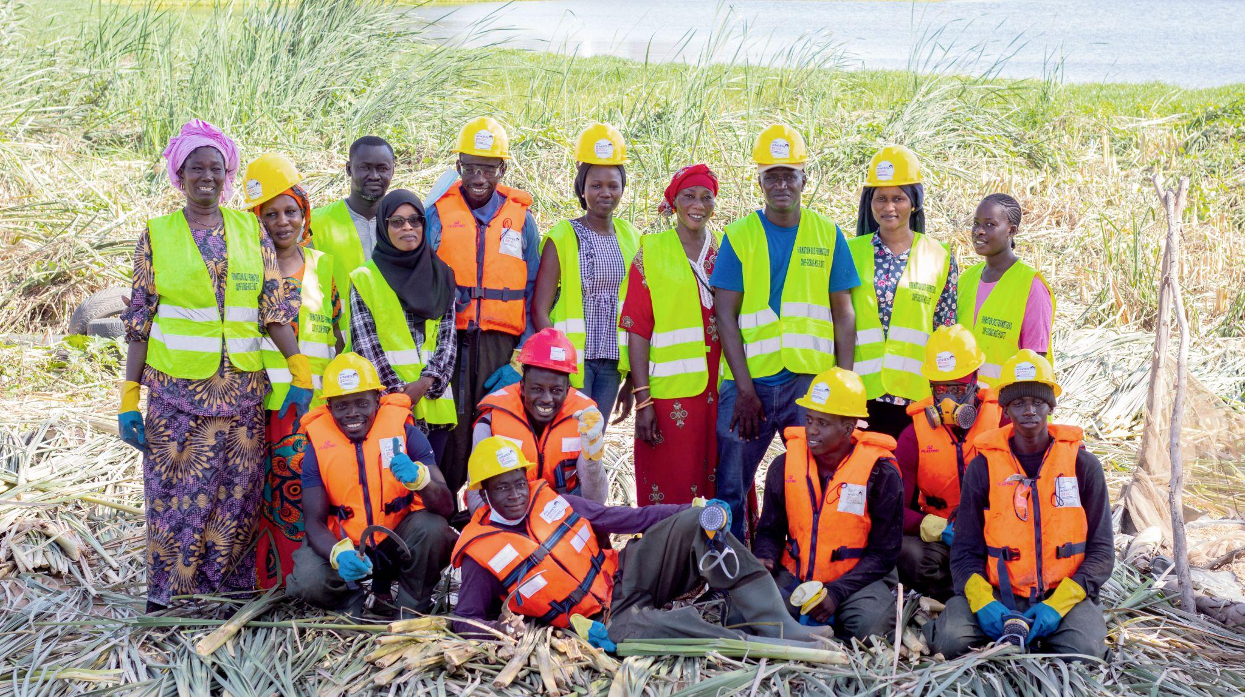
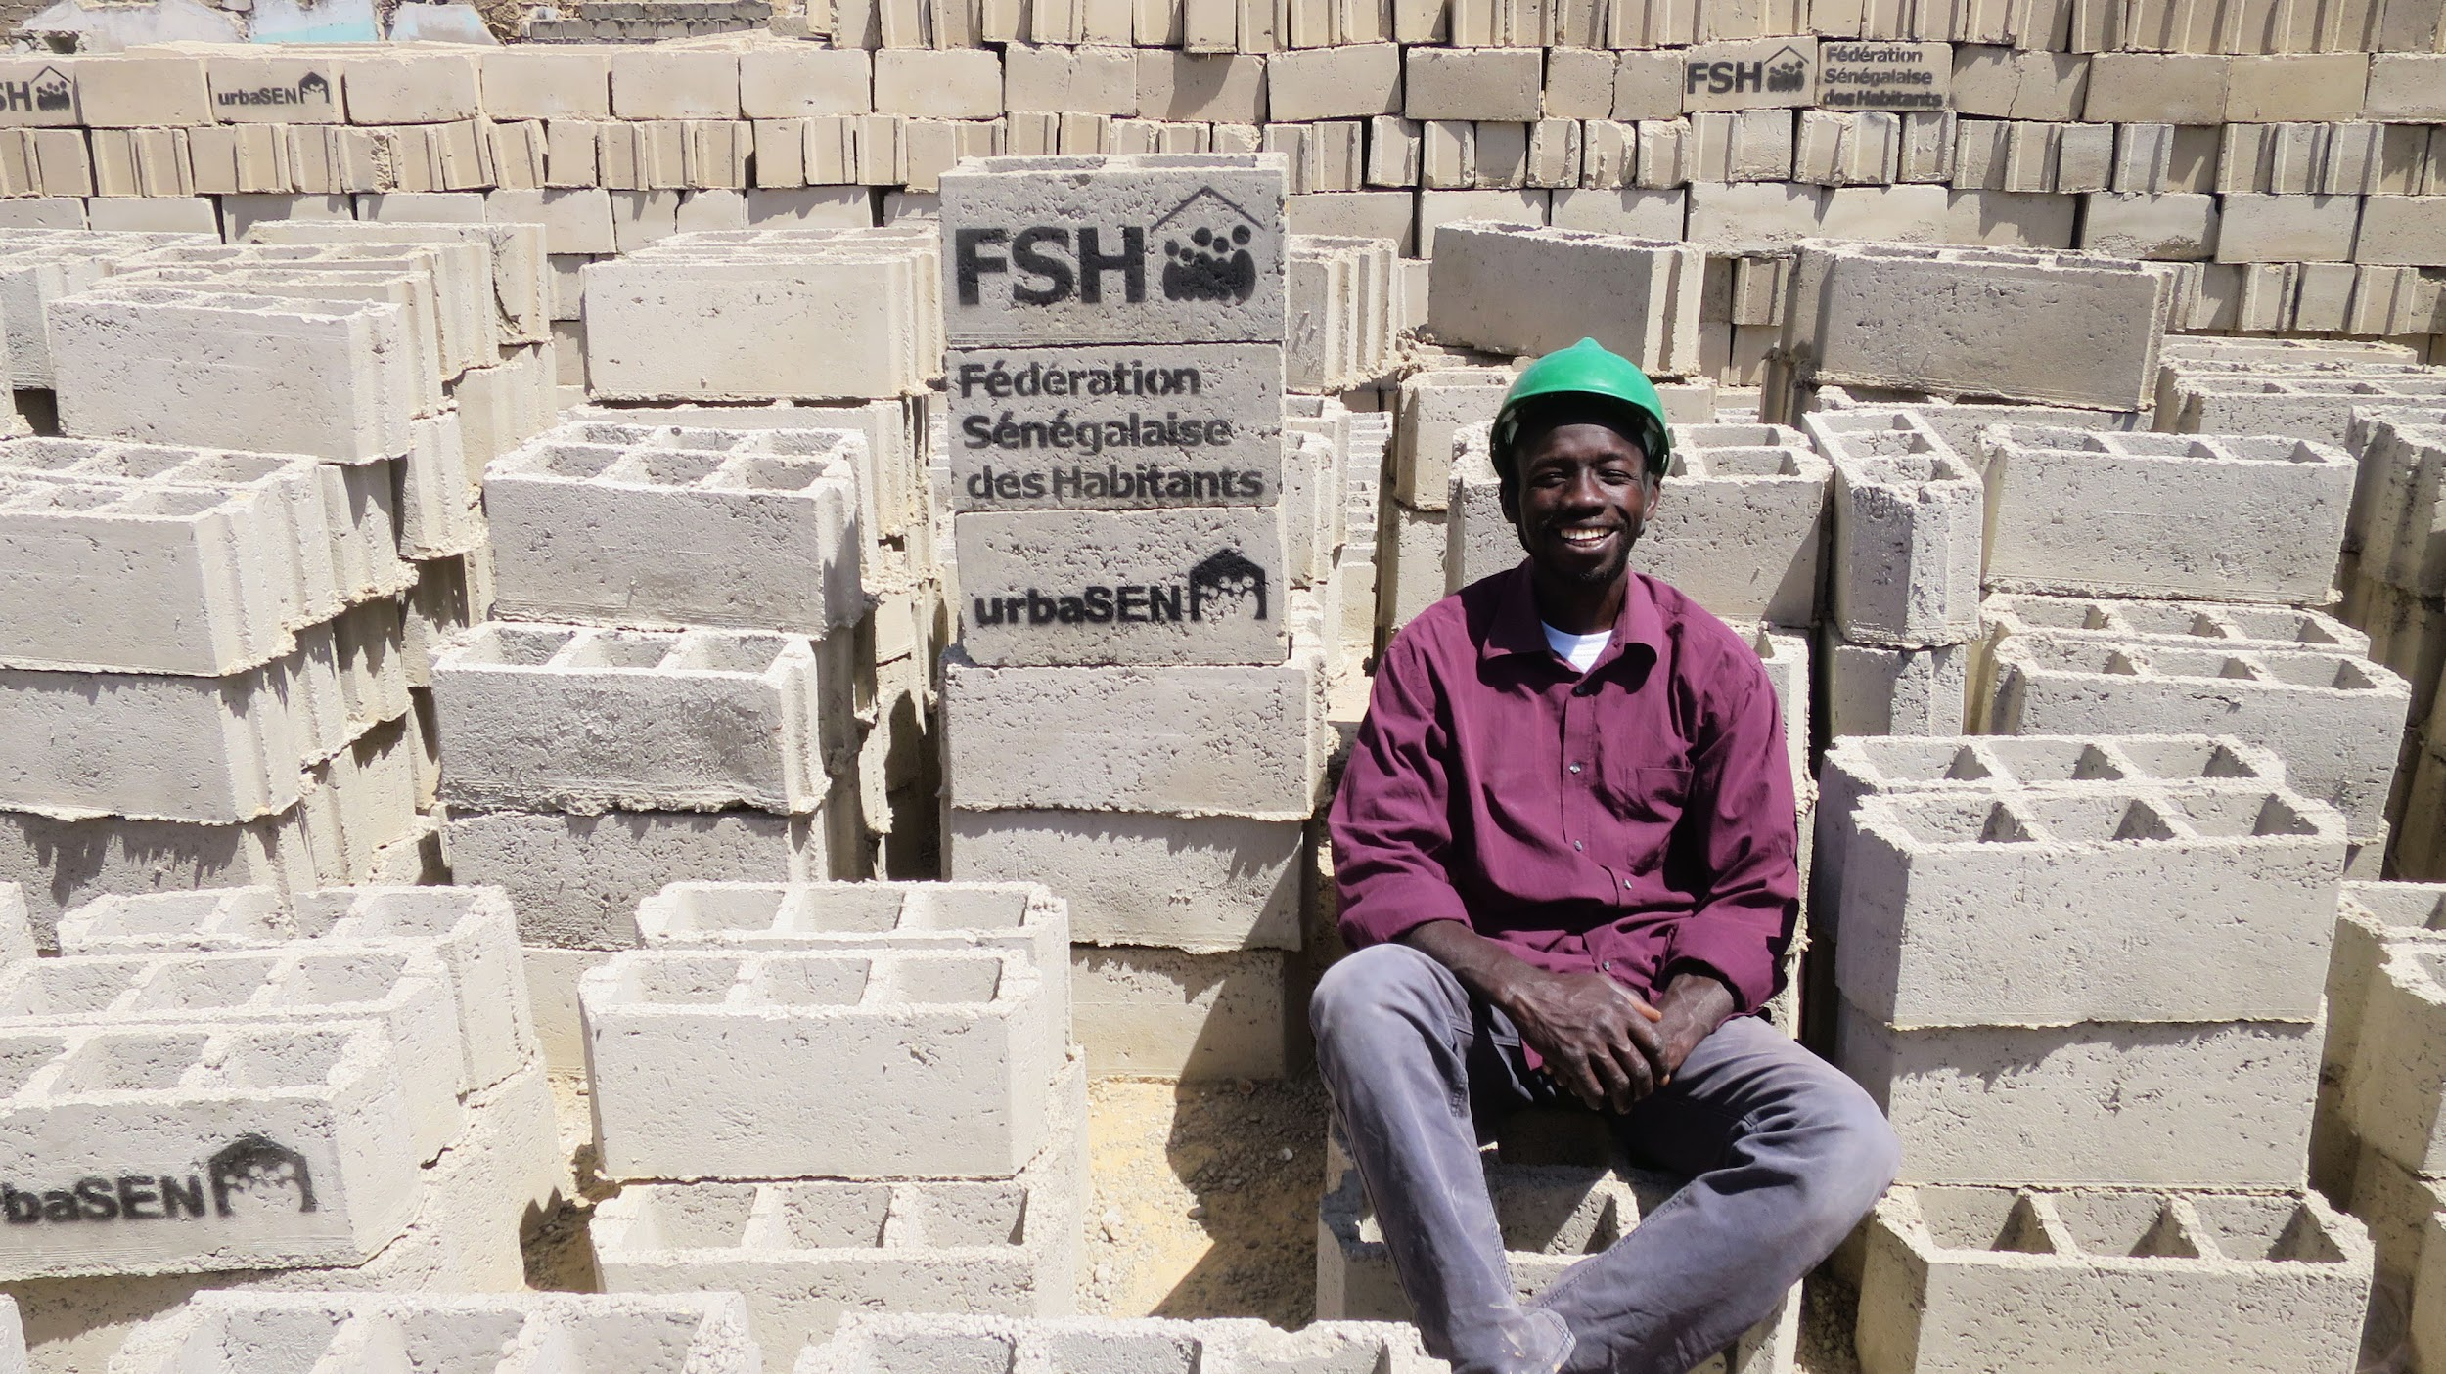
Senegalese NGO created in 2009
20 urban and community development professionals
A credo: residents at the heart of urban development
and neighborhood management
Ongoing dialogue with FSH and authorities

Slide 4
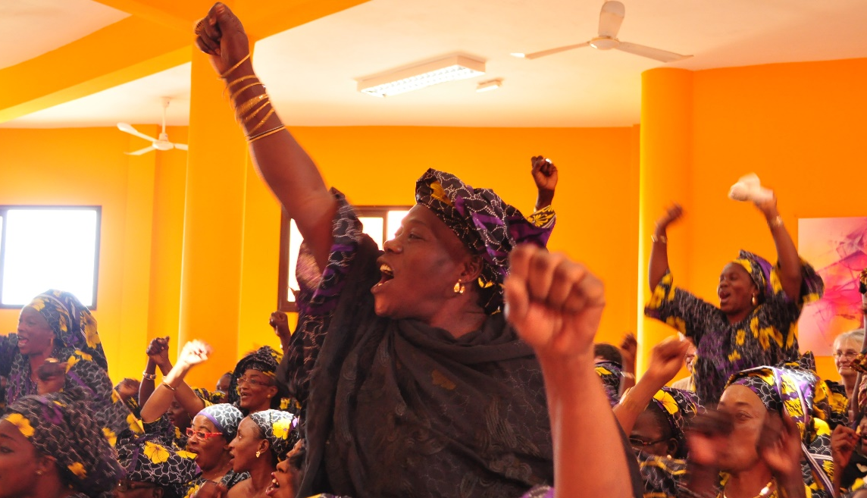
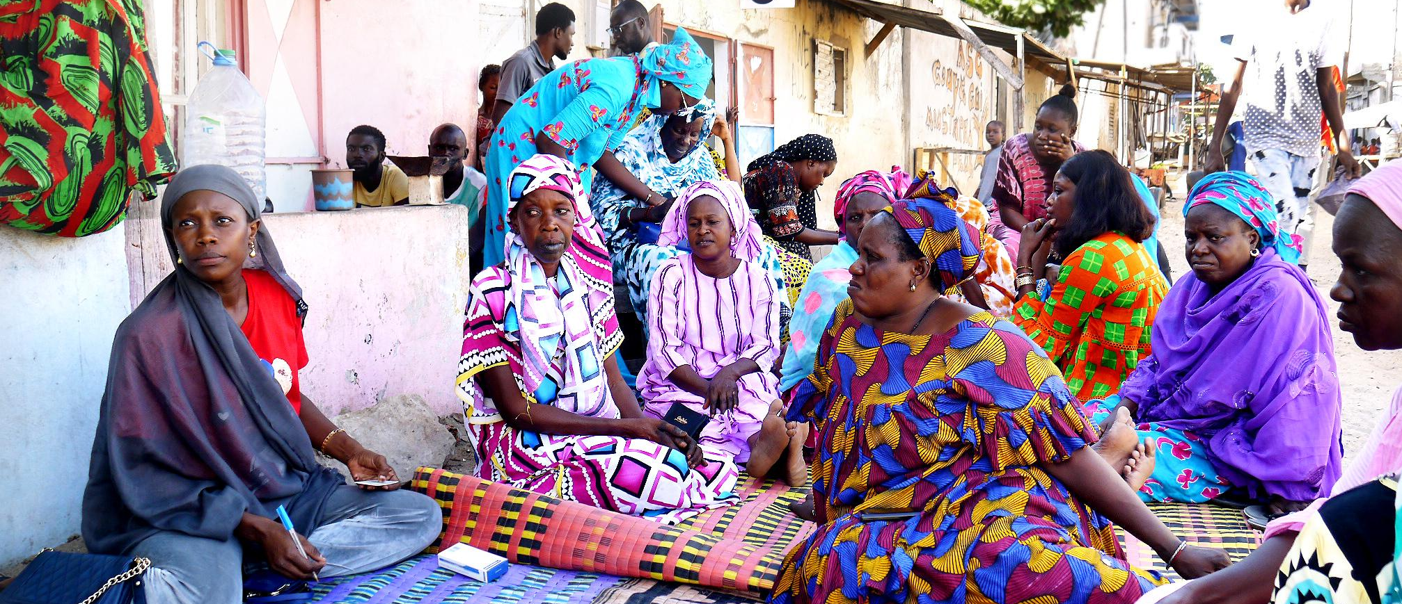
Senegalese Federation of Inhabitants
Created in 2014
Nearly 17’000 members, 96% women
672 saving groups 1 revolving fund
Over 800 craftsmen trained, contributing to the implementation of projects

Slide 5
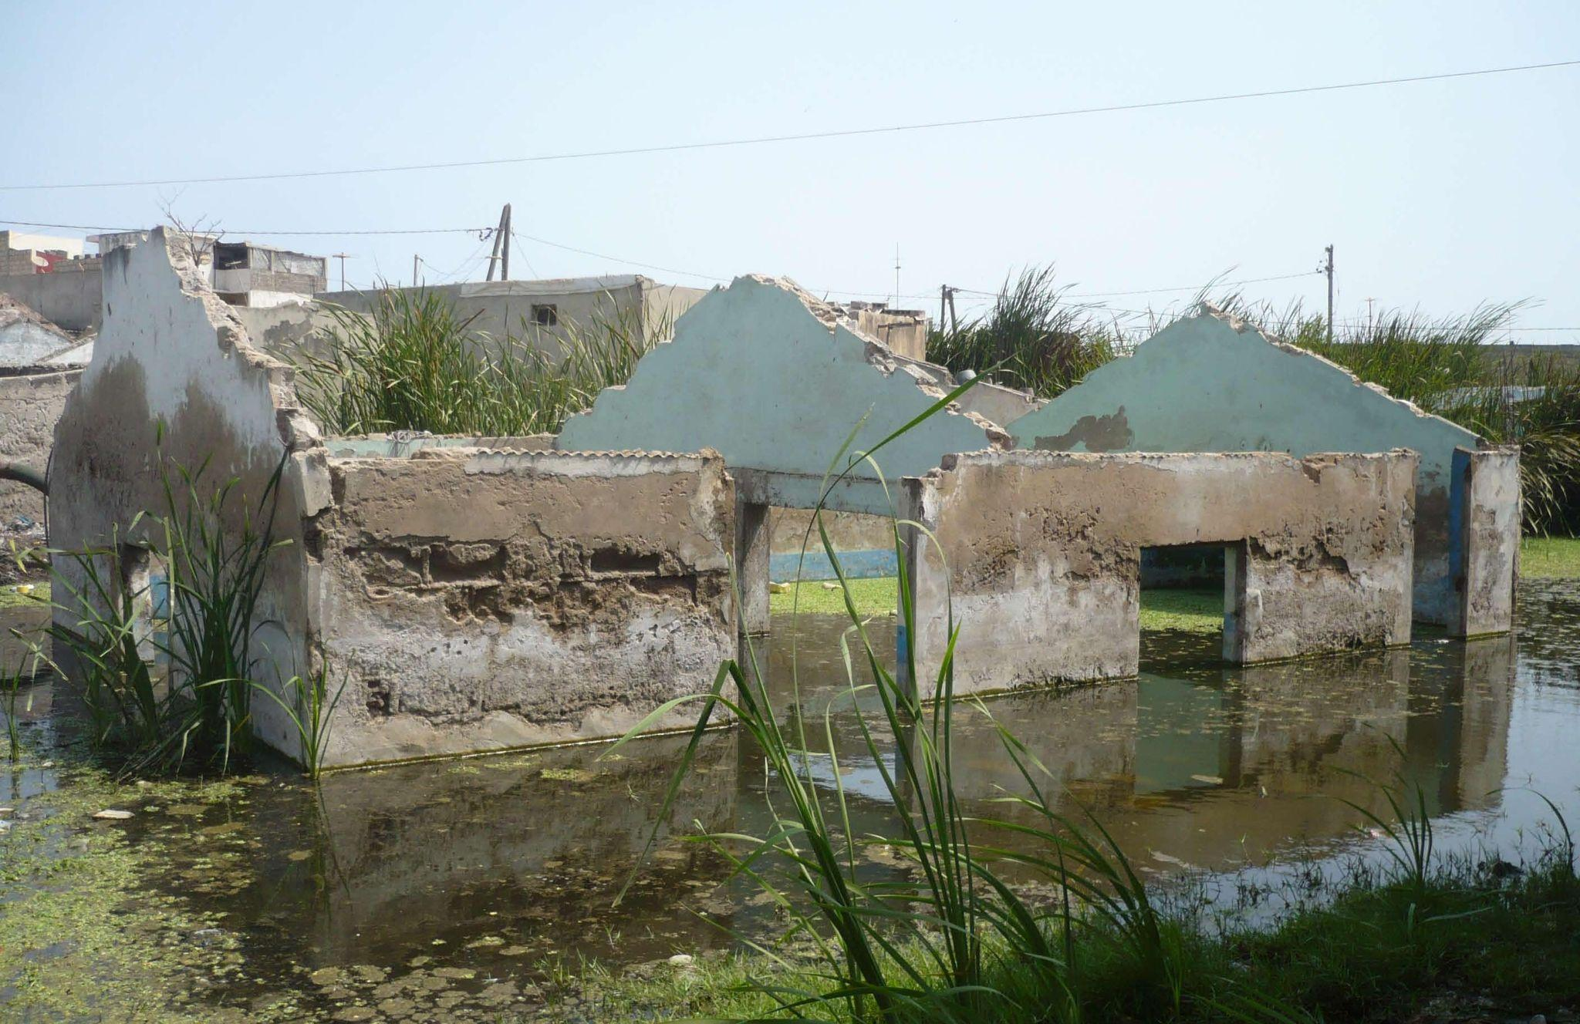
Flood risk in Dakar

Slide 6
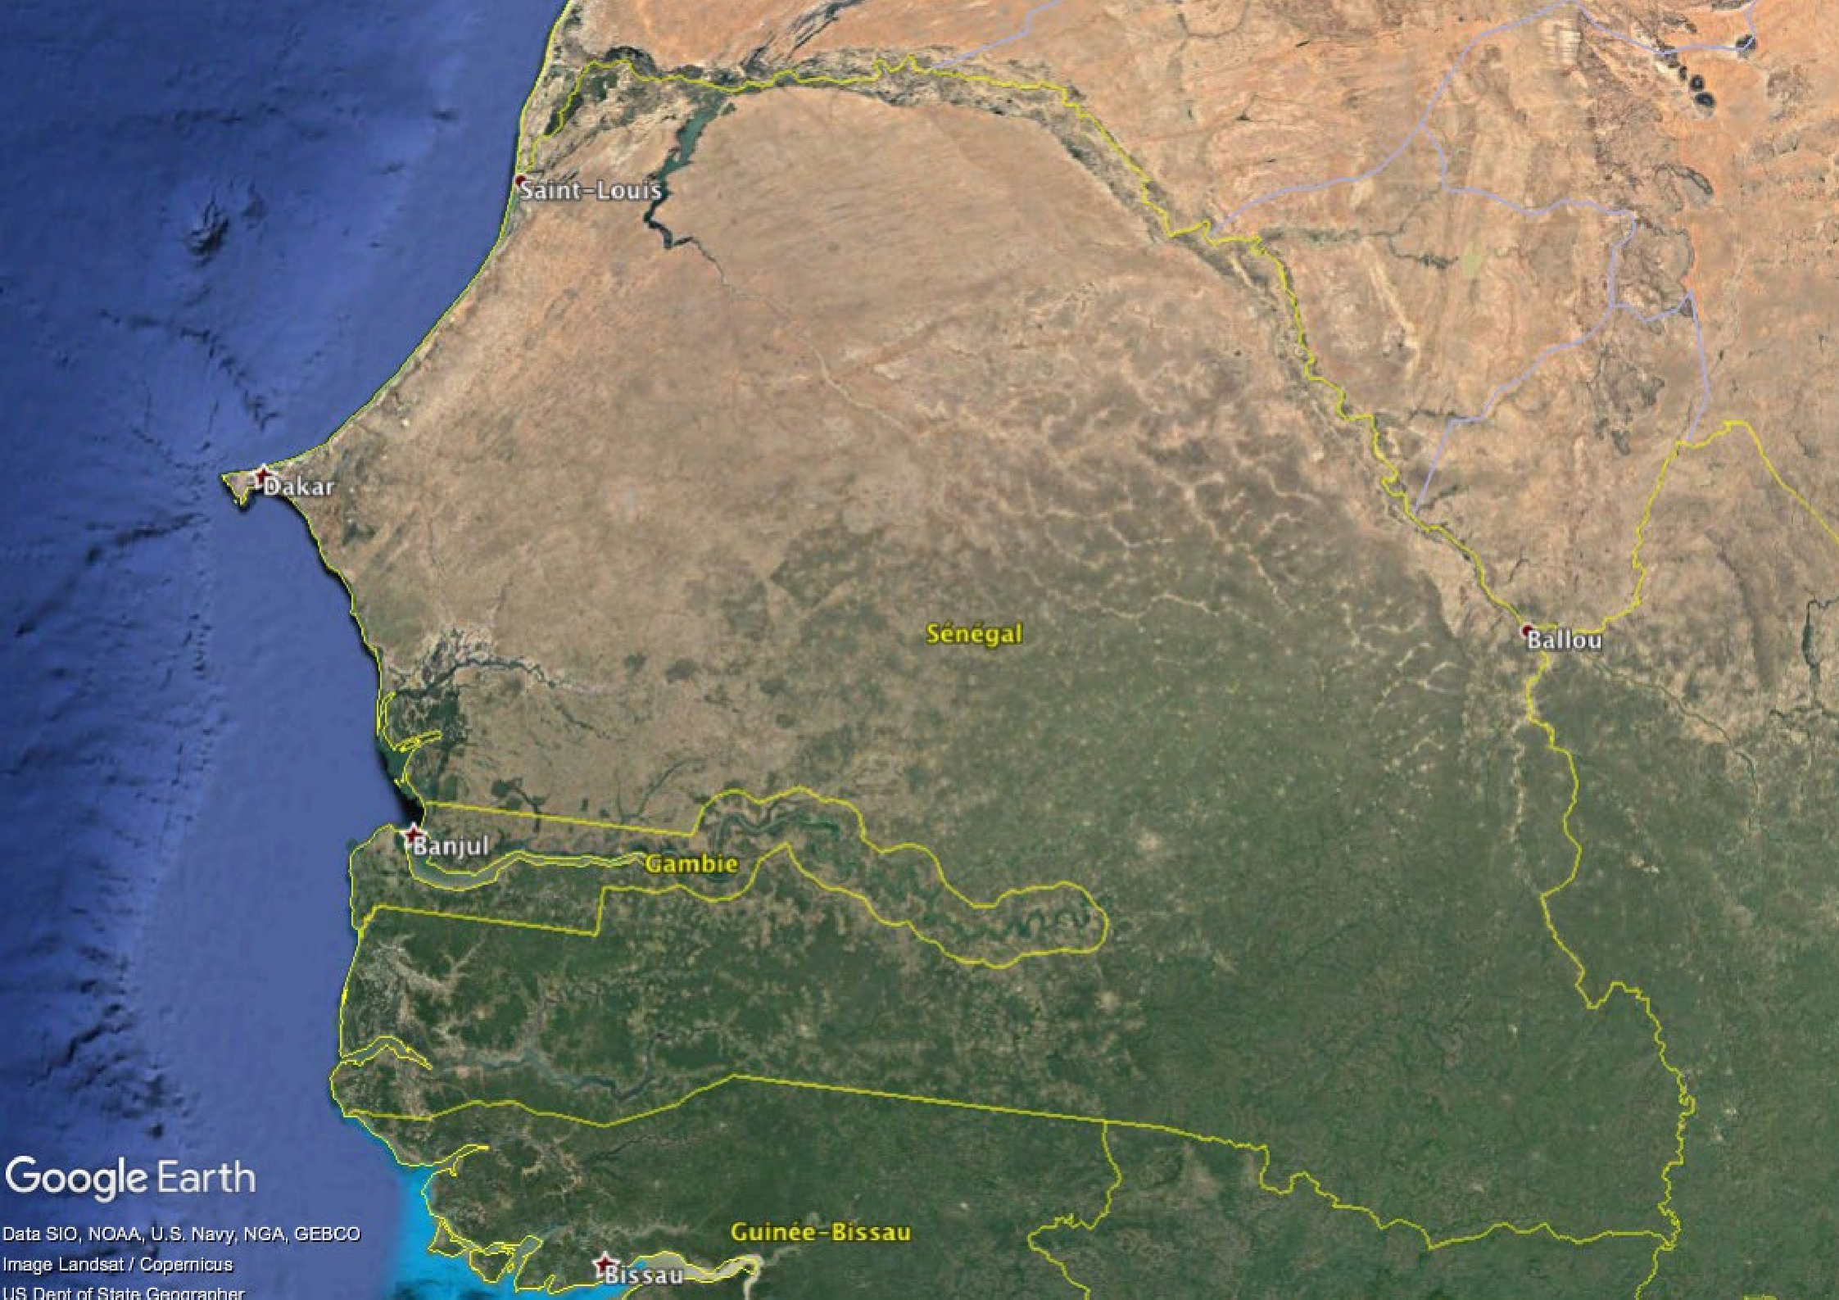
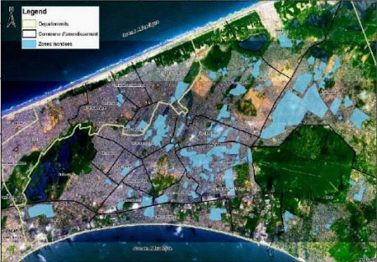
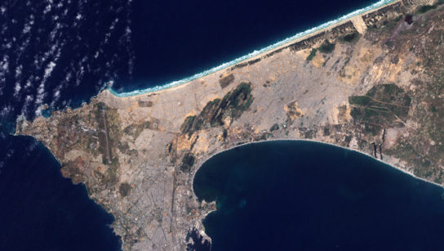
Floods in Dakar : stagnant water at an extensive scale

Slide 7
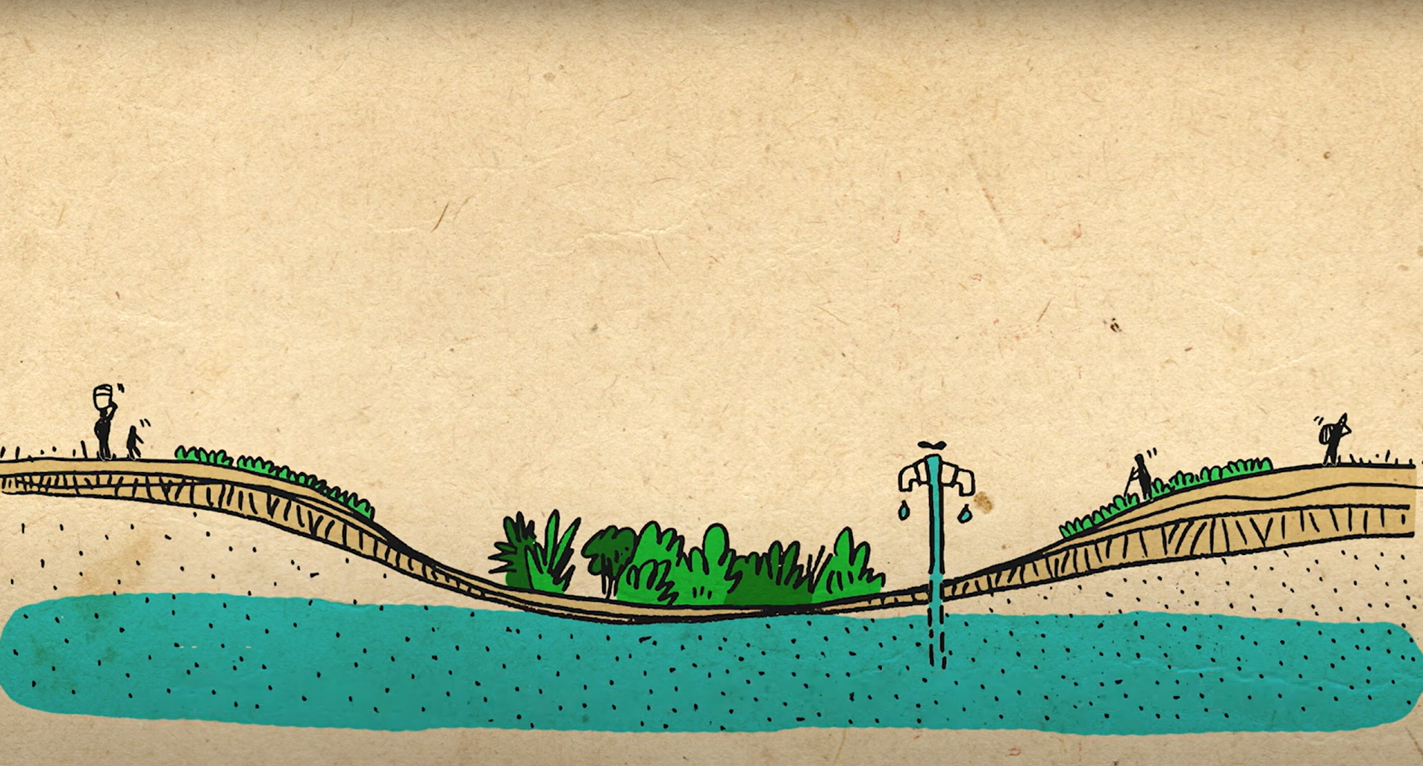
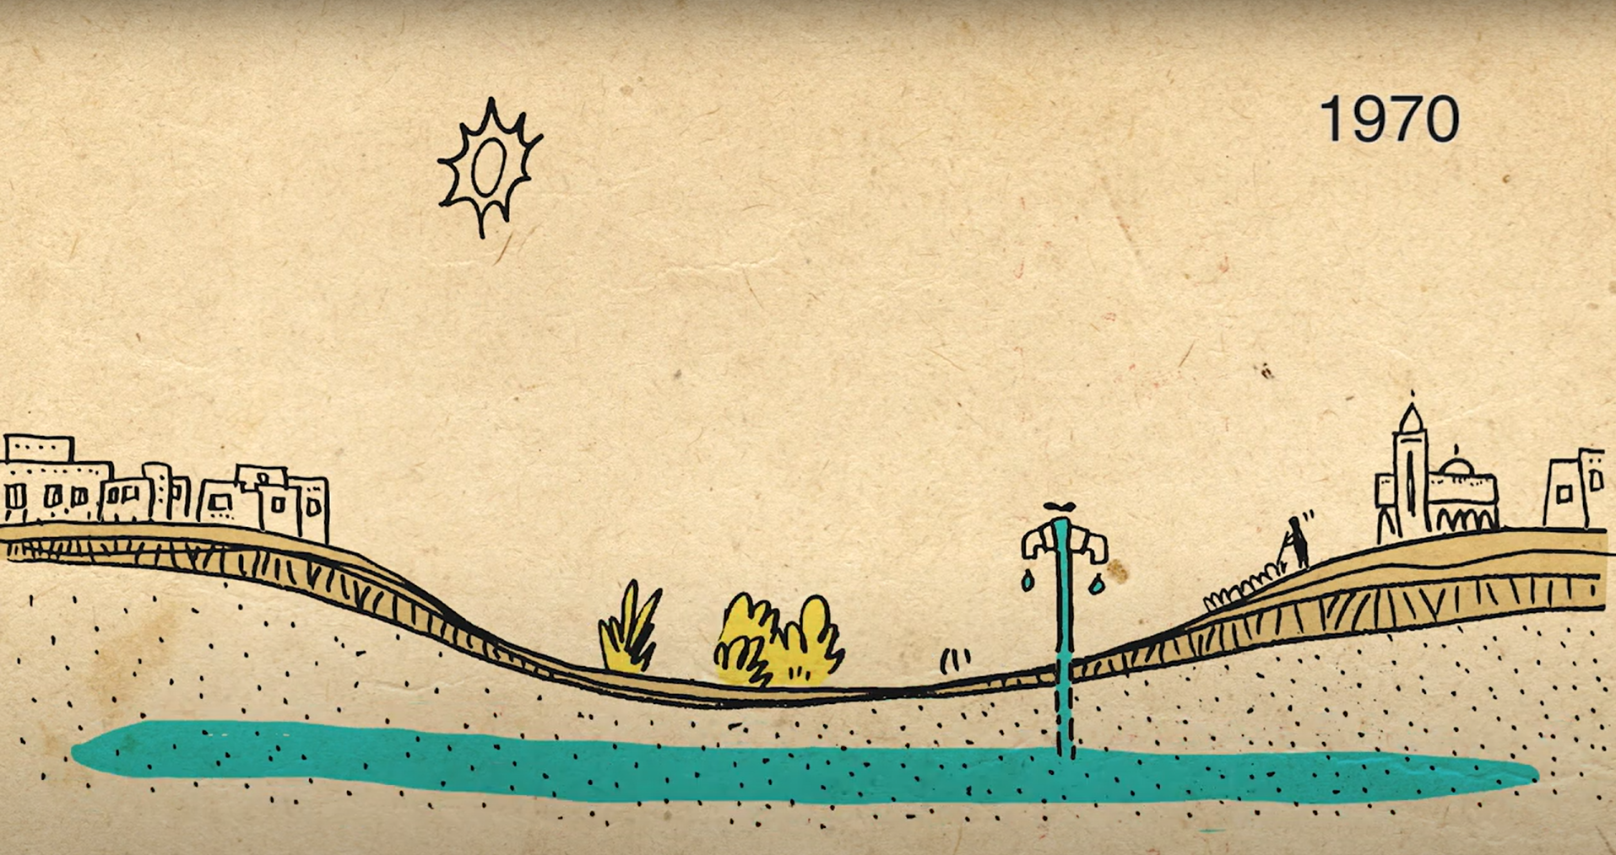
History of floods in Dakar
In Dakar region, until the 1970s, the groundwater was used for agriculture and pumped to supply Dakar with drinking water.
During the 1970s, the urbanisation of these low-lying areas, combined with a period of severe drought, contributed to the drying up of the groundwater.

Slide 8
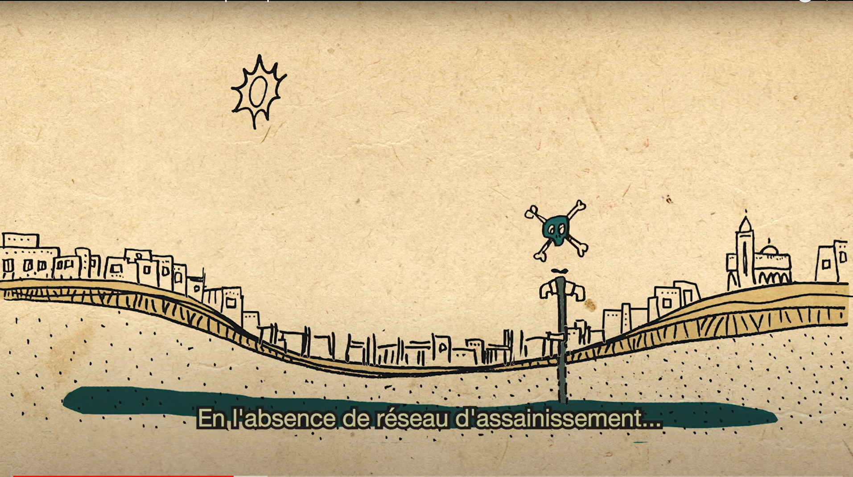
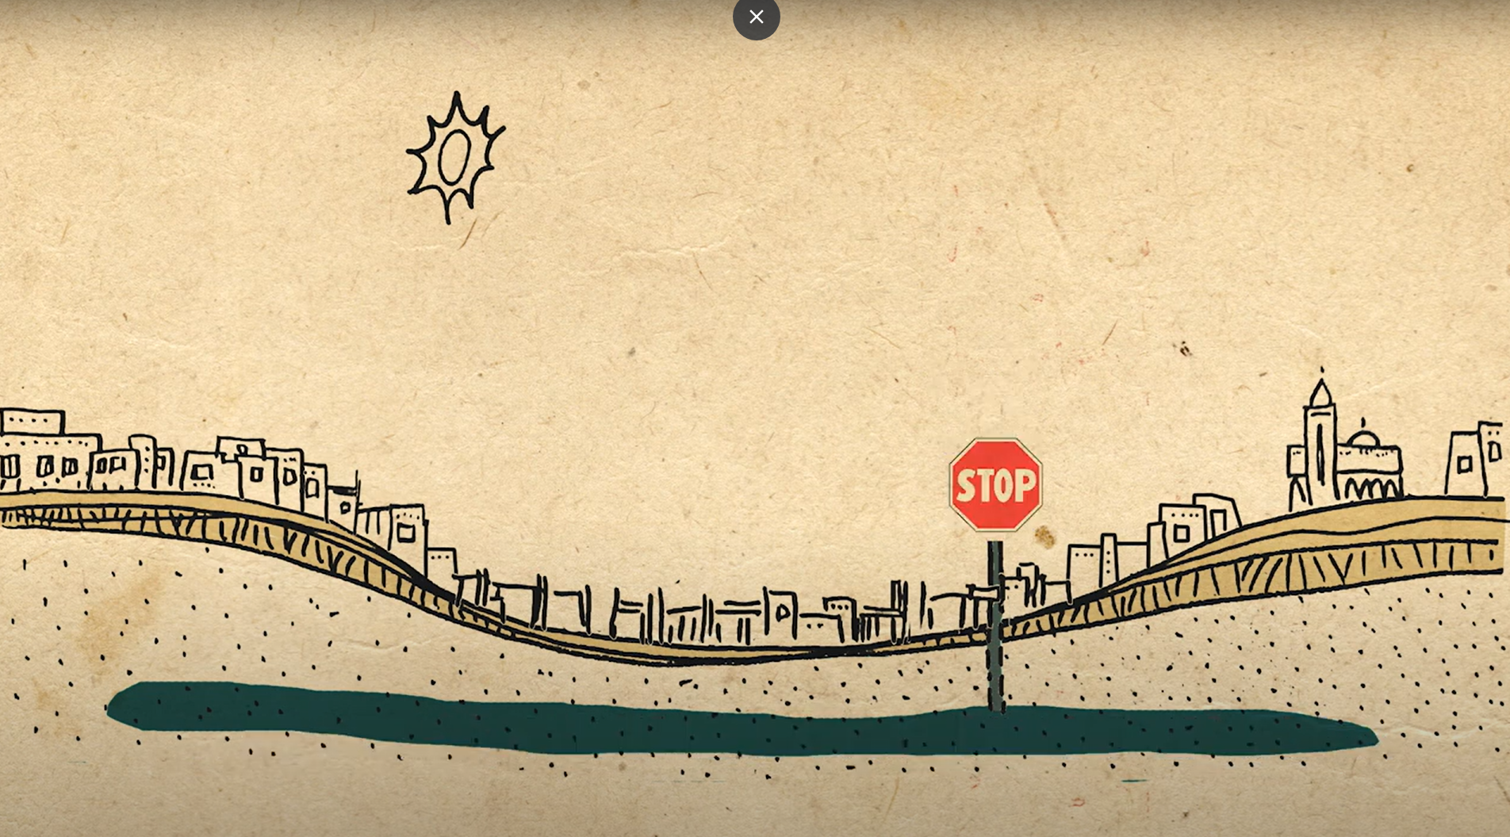
History of floods in Dakar
During the 1980s, continued urbanization without any sanitation services contaminated the groundwater which could not be used as drinking water any longer.

Slide 9
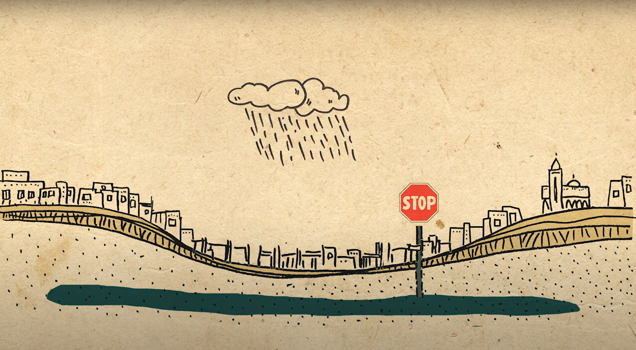
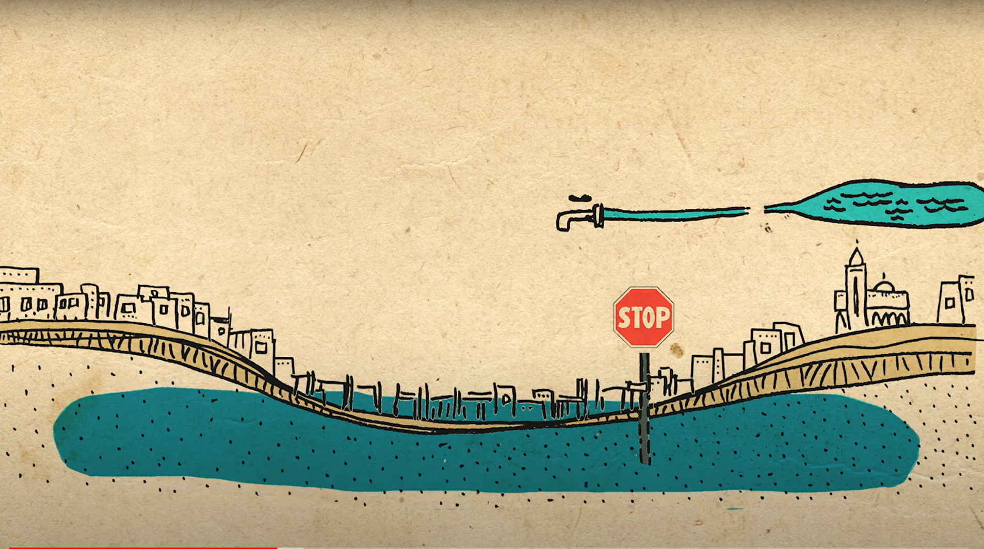
History of floods in Dakar
At the beginning of the 1990s, the precipitation levels came back to a normal level after years of drought.
The groundwater increased, and some parts of Dakar began to suffer from continuous flooding.

Slide 10
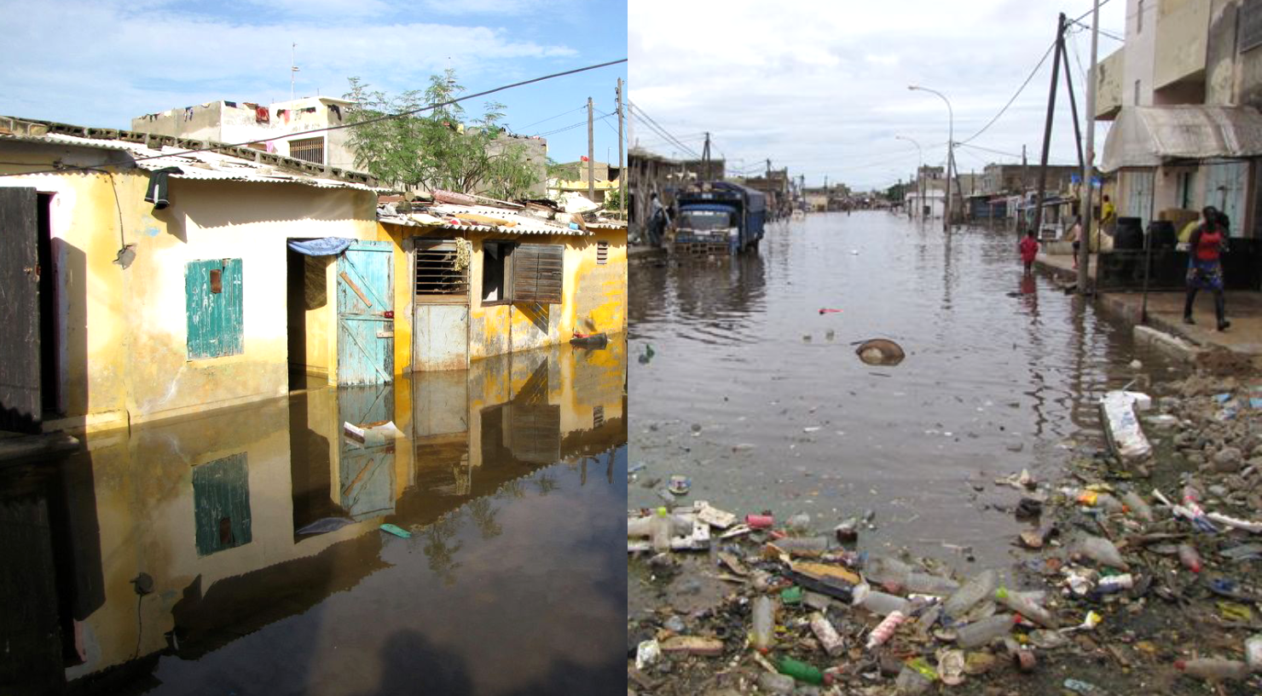
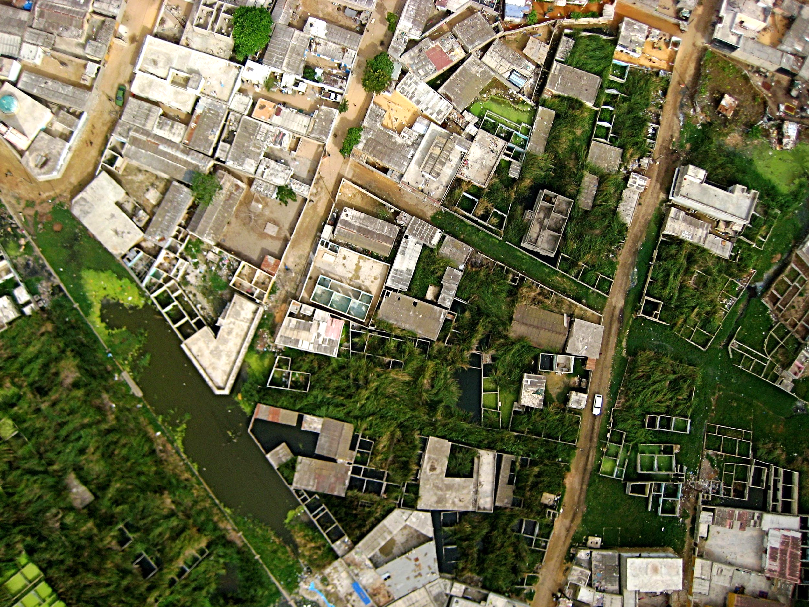
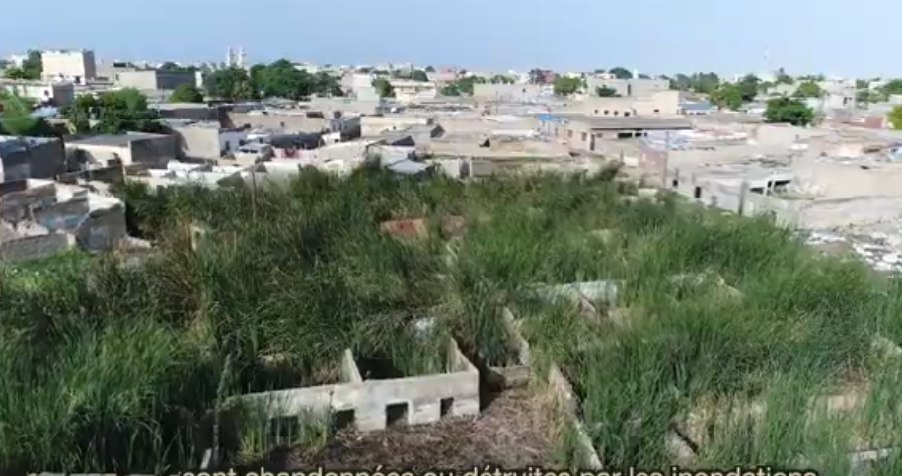
History of floods in Dakar
As a result, many properties were abandoned by their inhabitants

Slide 11
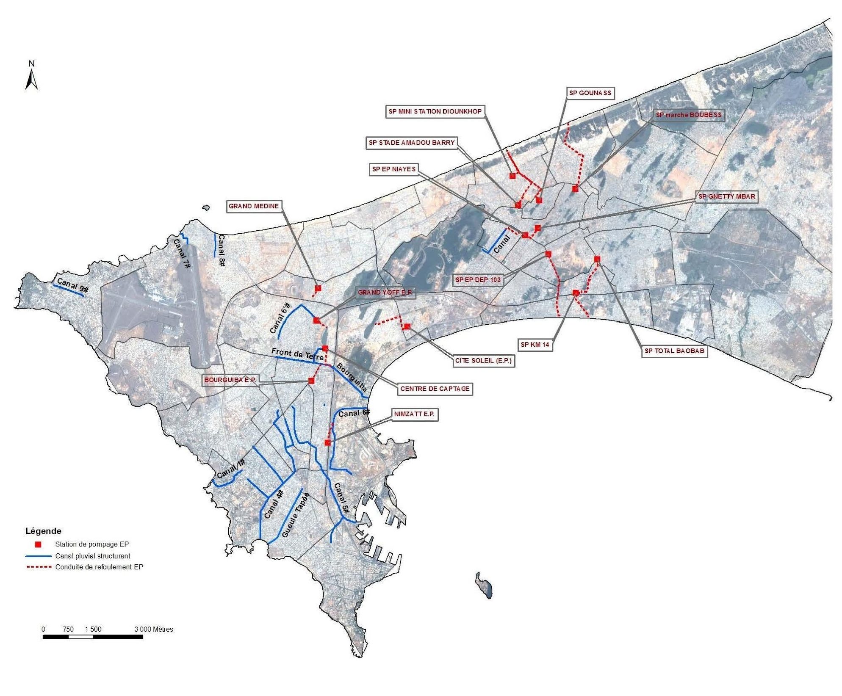
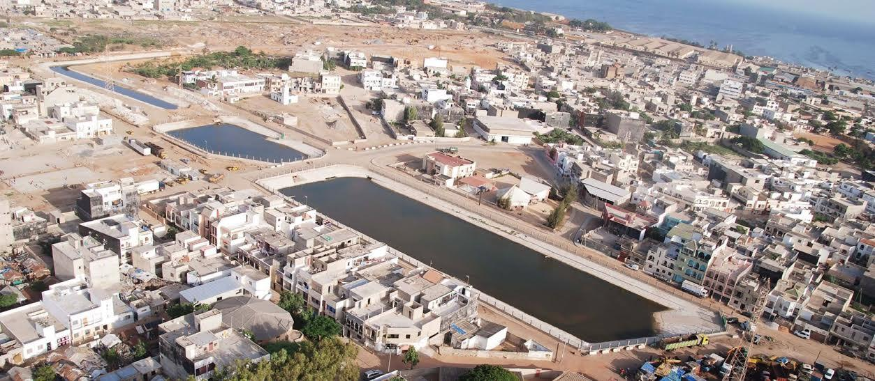
Public answer to floods: urban-water policies
Thanks to public policies and development projects, rainwater drainage infrastructure has been built in Dakar since the years 2000-2010.
But large residential zones are still left without solutions and remain regularly flooded, particularly unplanned areas lacking water and sanitation infrastructure (informal areas) in the suburbs.

Slide 12
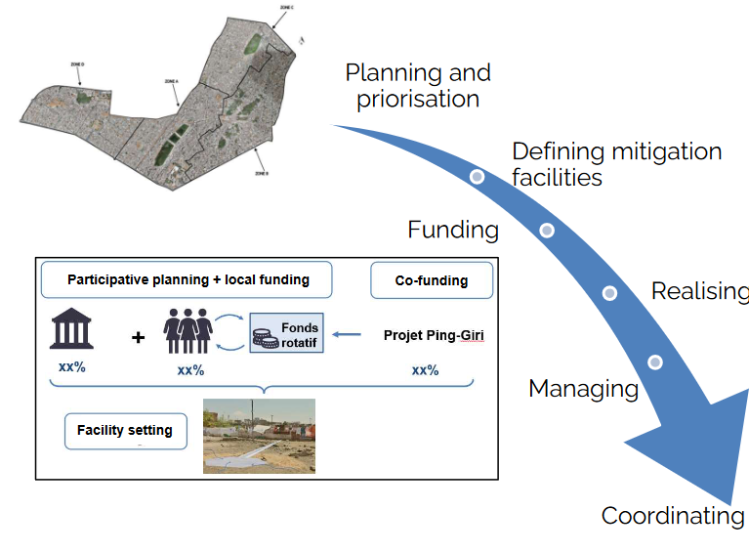
Community-based approach: integrated flood risk management
Approach implemented in 5 municipalities of Dakar suburbs by
urbaMonde, urbaSEN, FSH and Gret
PING-GIRI project (2019-2023, funded by AFD)
PING2 (2023-2025, French regional authorities)
ASG-GIRI (2024-2027, AFD)

Slide 13
Shared project ownership and financing
Participatory diagnostic and co-design : local authorities, municipal technicians, local residents and the project team work together to identify problems and find solutions adapted to the local context.
Co-financing of the works by local authorities and residents.
The FSH revolving fund is used to finance the works:
Individual loans for housing renovation
Collective loans to groups of residents for the co-financing of collective facilities:
Semi-collective wastewater sumps shared by a few families
Larger-scale public facilities: drains, drainage paving, buffer basins, green spaces.
The residents participate in the management of the facilities.

Slide 14
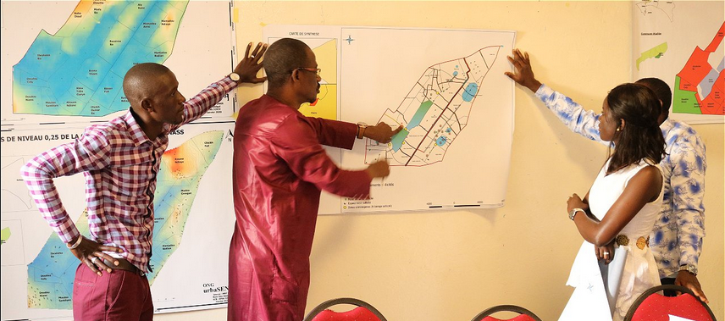
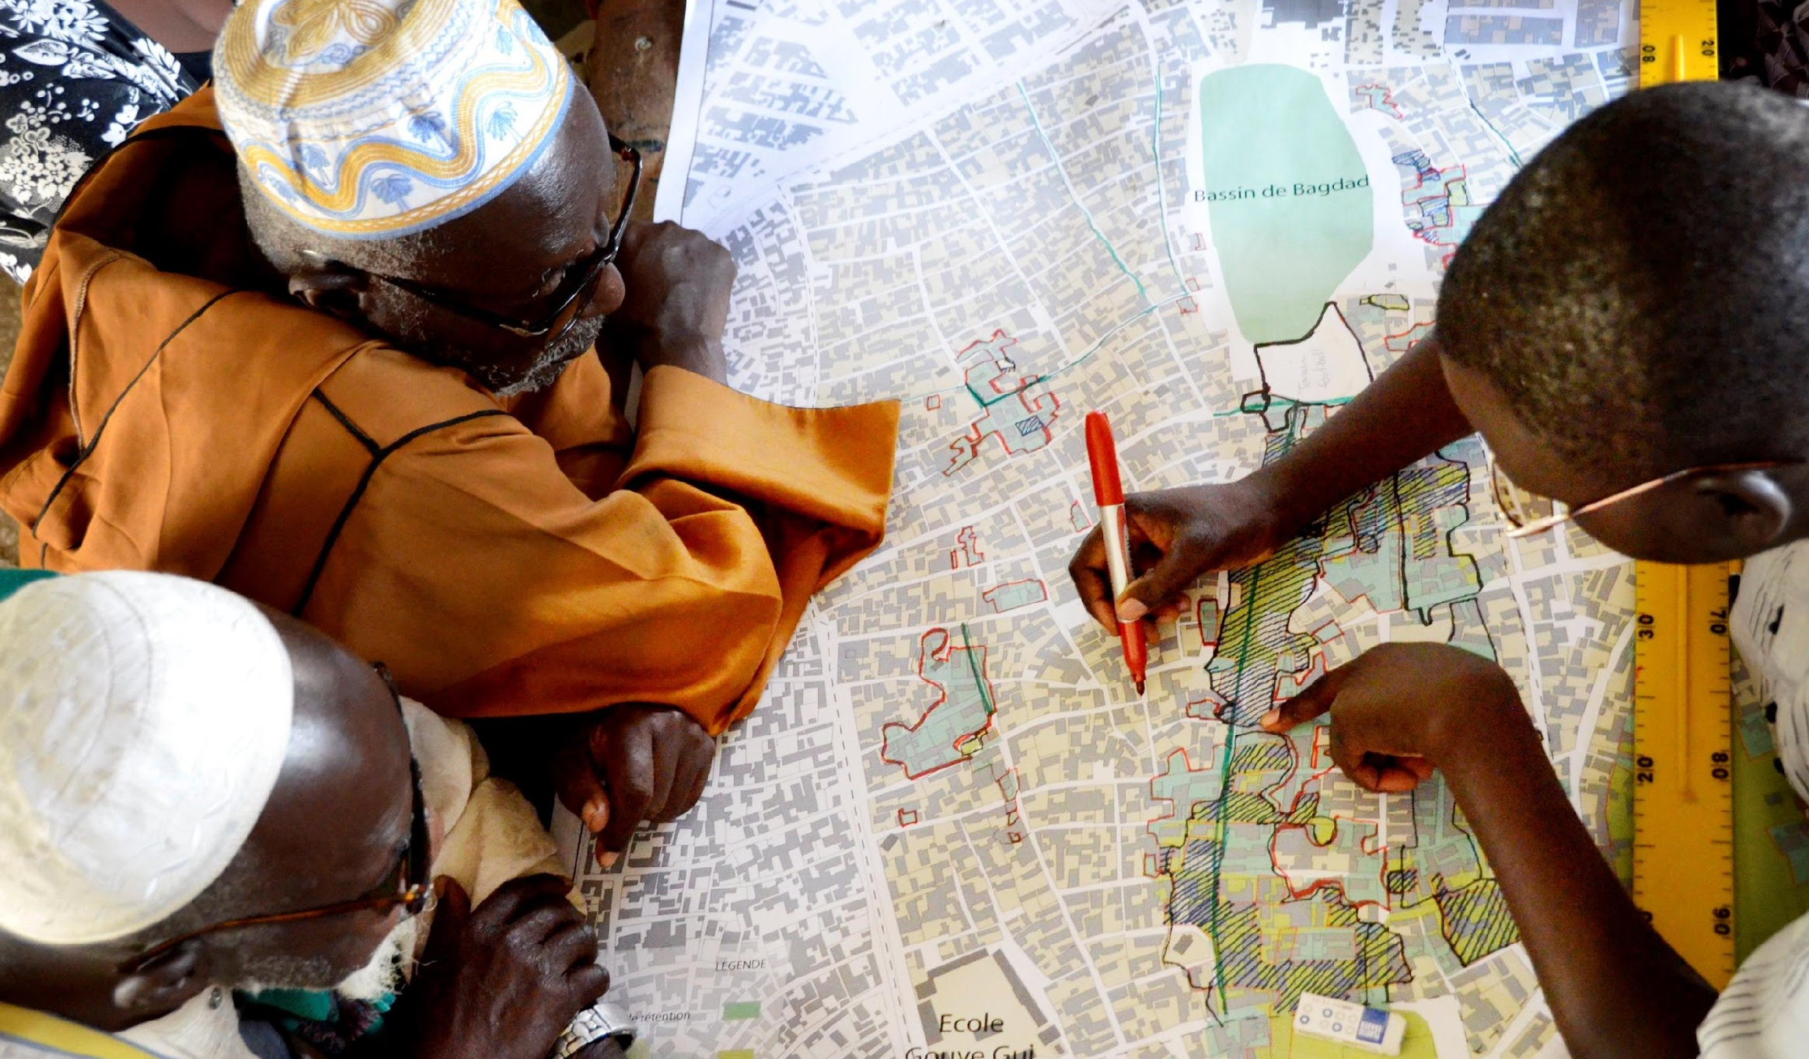
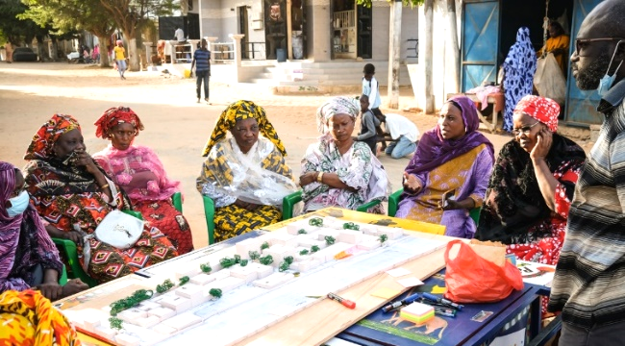
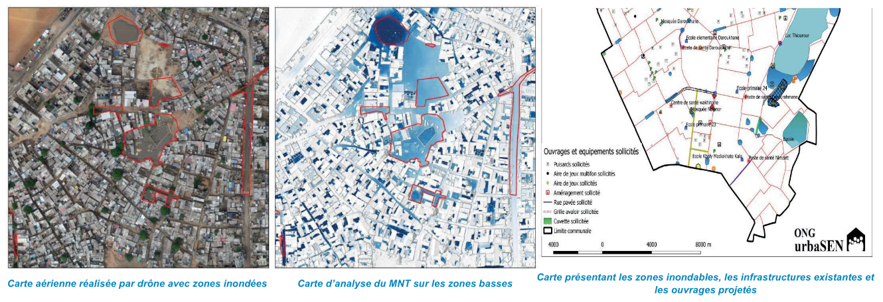
Participatory diagnostic and urban planning
Promote residents as local experts.
Organize dialogue between residents, local authorities, technical teams.
Share knowledge about the local flood issues and their solutions

Slide 15
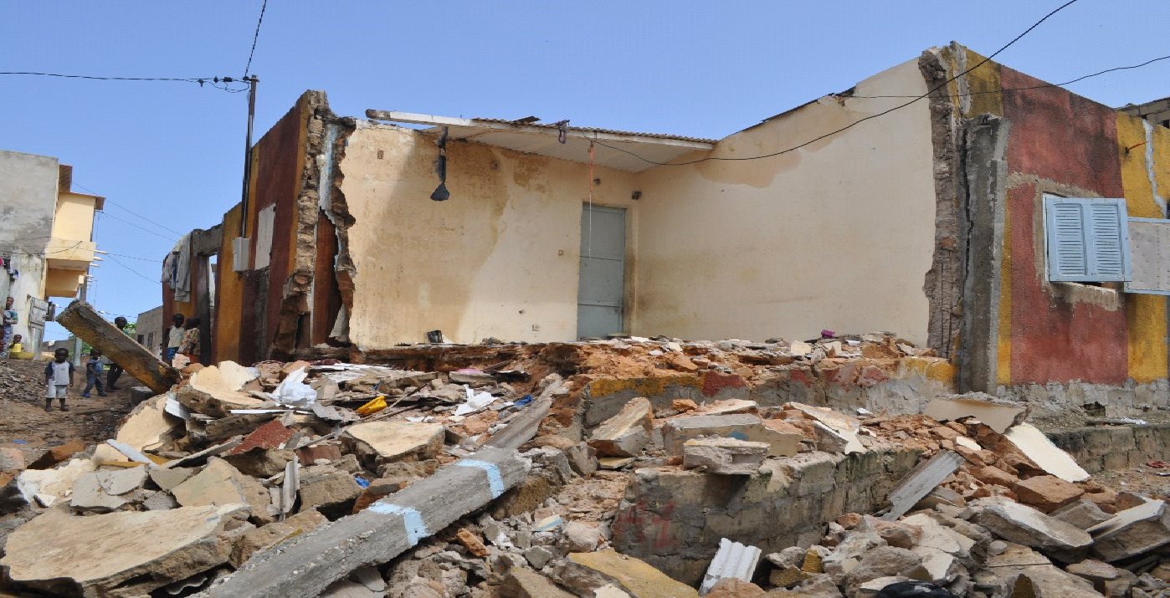
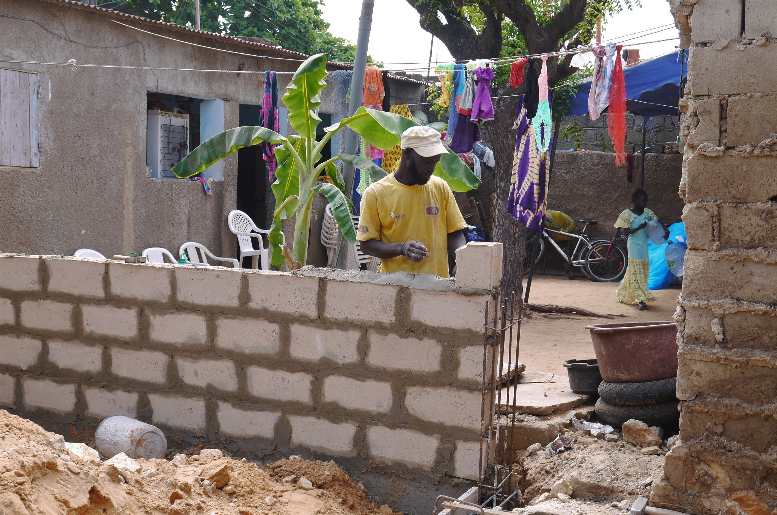
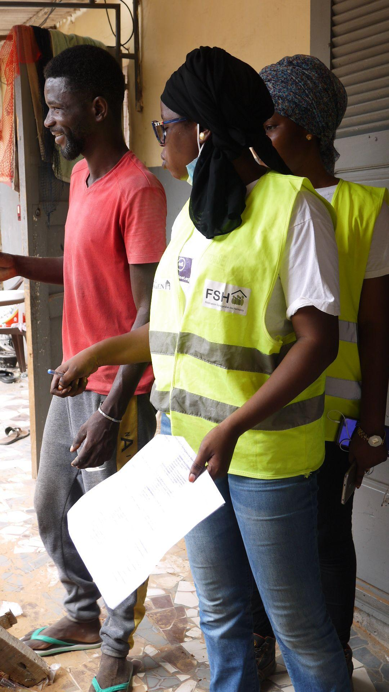
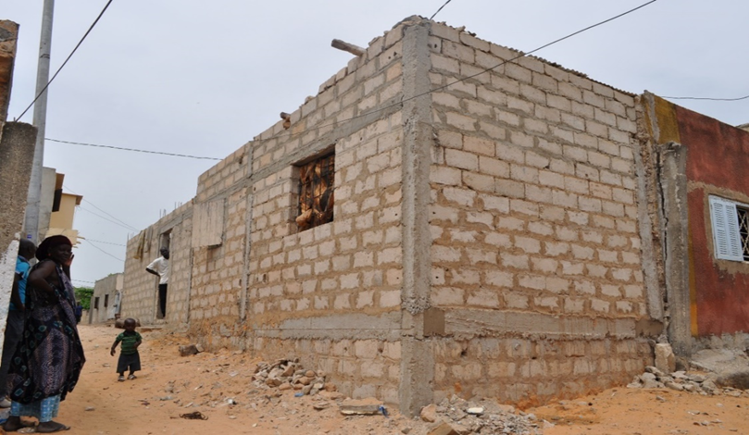
Housing improvement and adaptation with the revolving fund
Partial or total renovation of houses monitored by urbaSEN (1022 houses).
Funded by loans from the FSH revolving fund
Prevention before rainy season or repair of flood damages.
Creation of family sanitary facilities.
Support and training for local craftsmen.

Slide 16
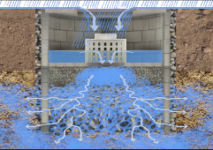
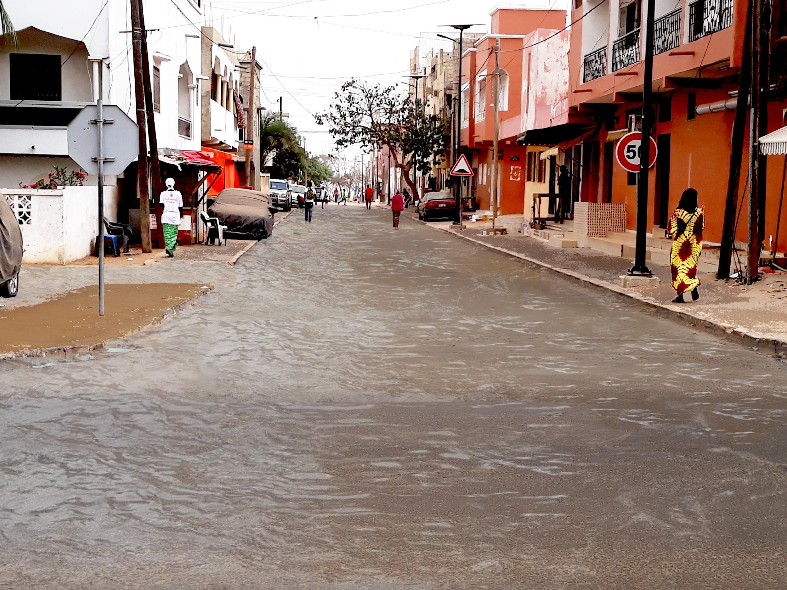
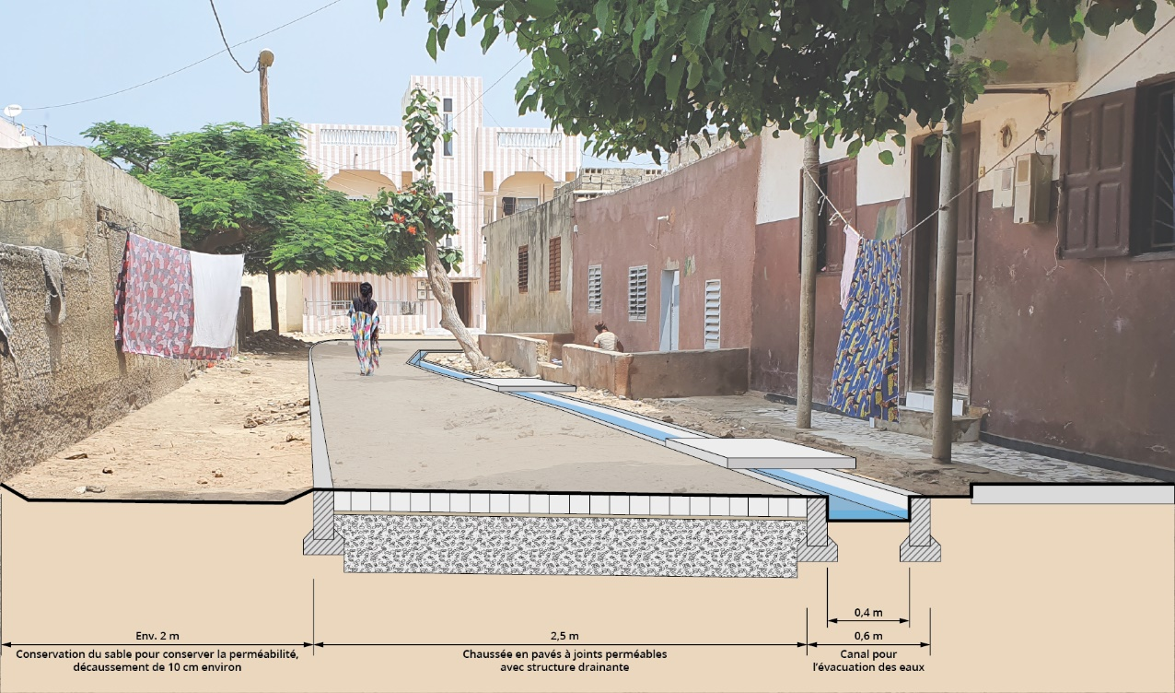
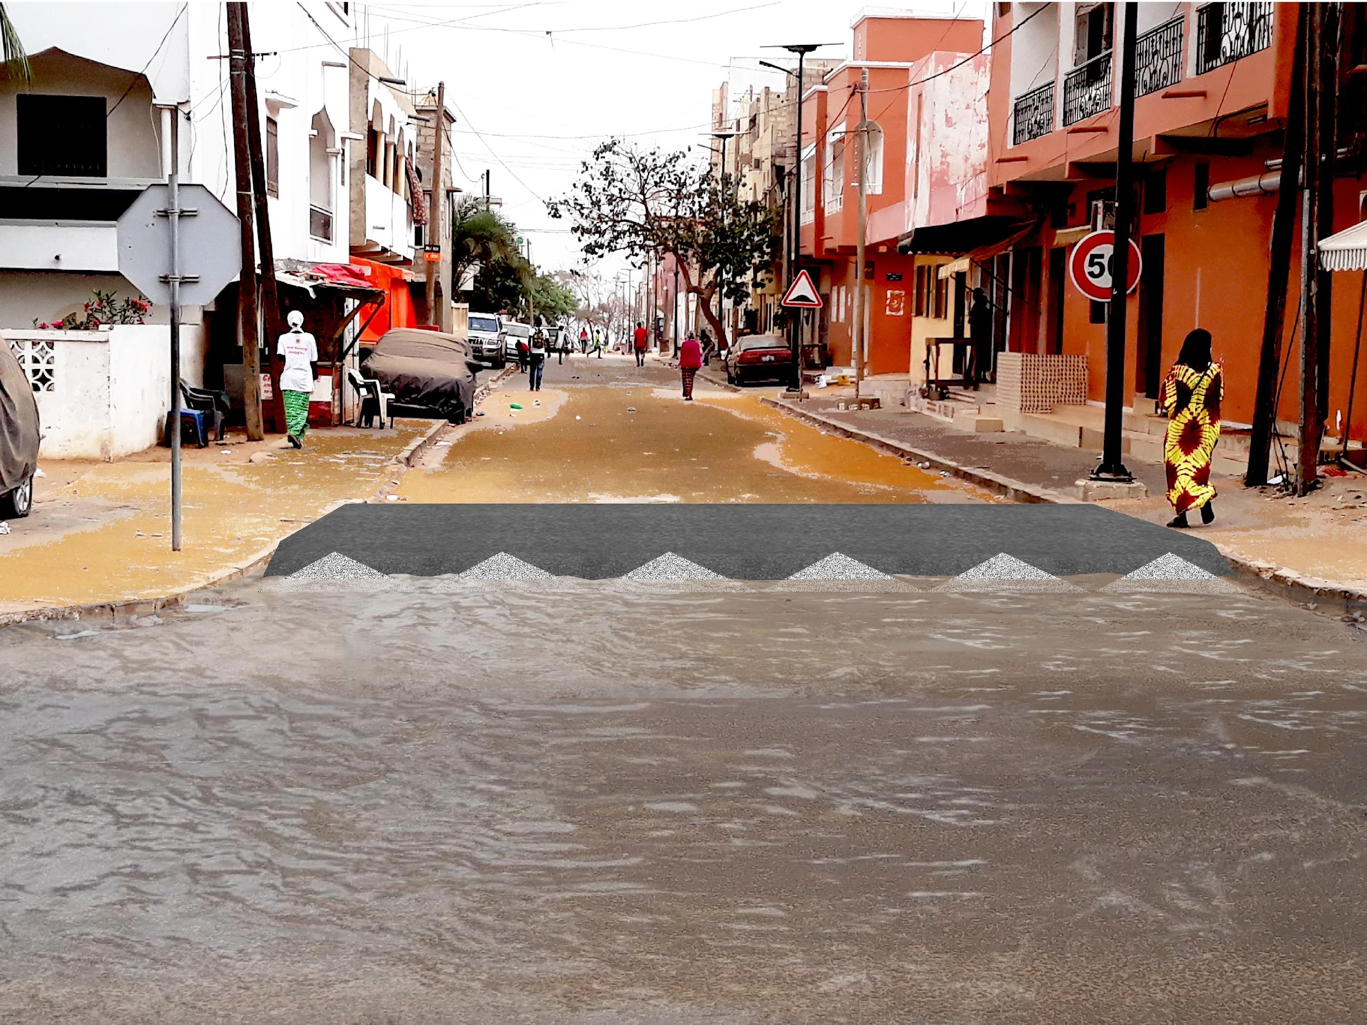
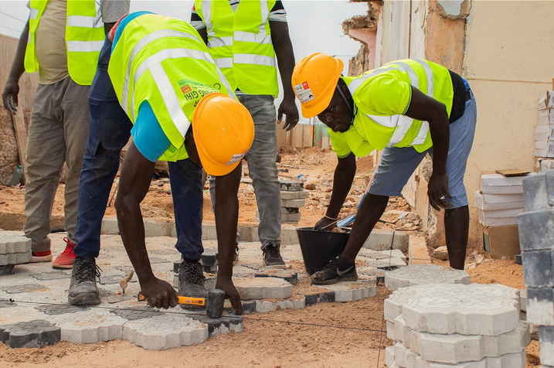
Low-tech community facilities
Before
After
Conceive and experiment adapted technics:
Enable water to infiltrate into the ground
Channel water on main roads / “water stoppers” at the entry of smaller streets
Training of local craftsmen (over 800) to realize and manage simple facilities

Slide 17
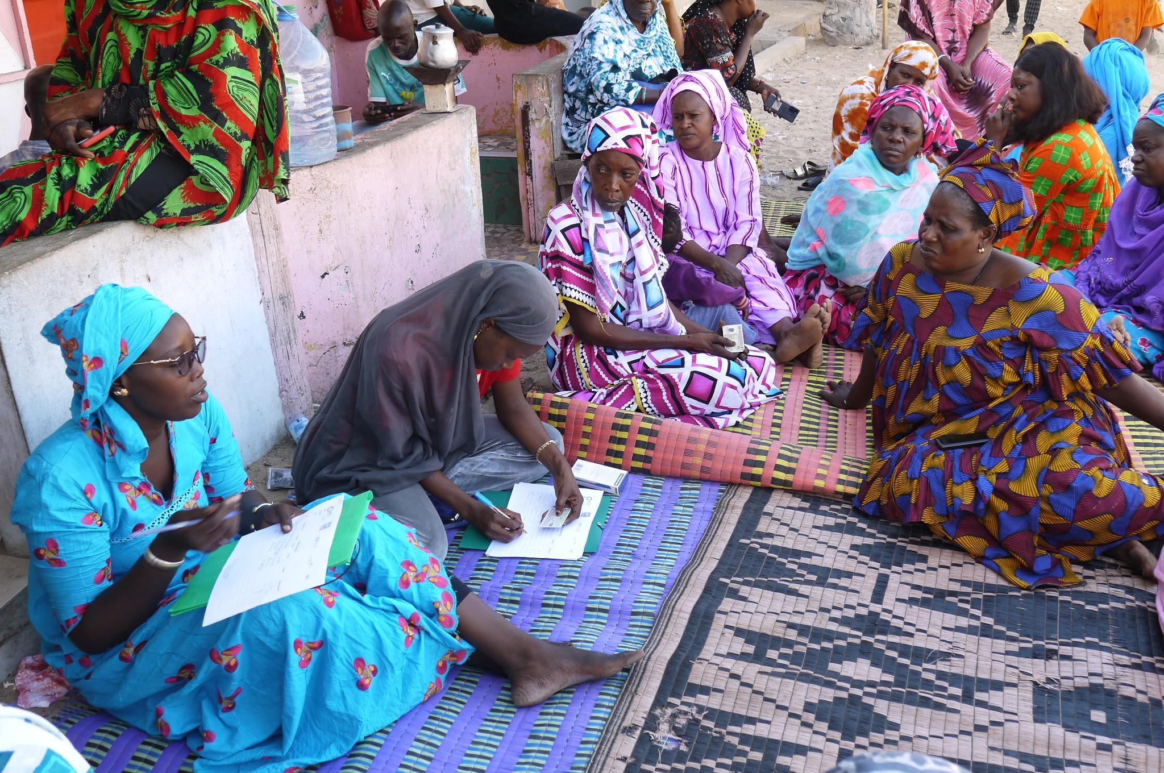
Raising awareness
Information and awareness raising of residents on good practices in case of heavy rains and flooding, housing renovation, collective action…
Alert system: vocal warning messages sent out before heavy rain (partnership with the meteorological agency): 500 people receive and then pass on the messages.

Slide 18
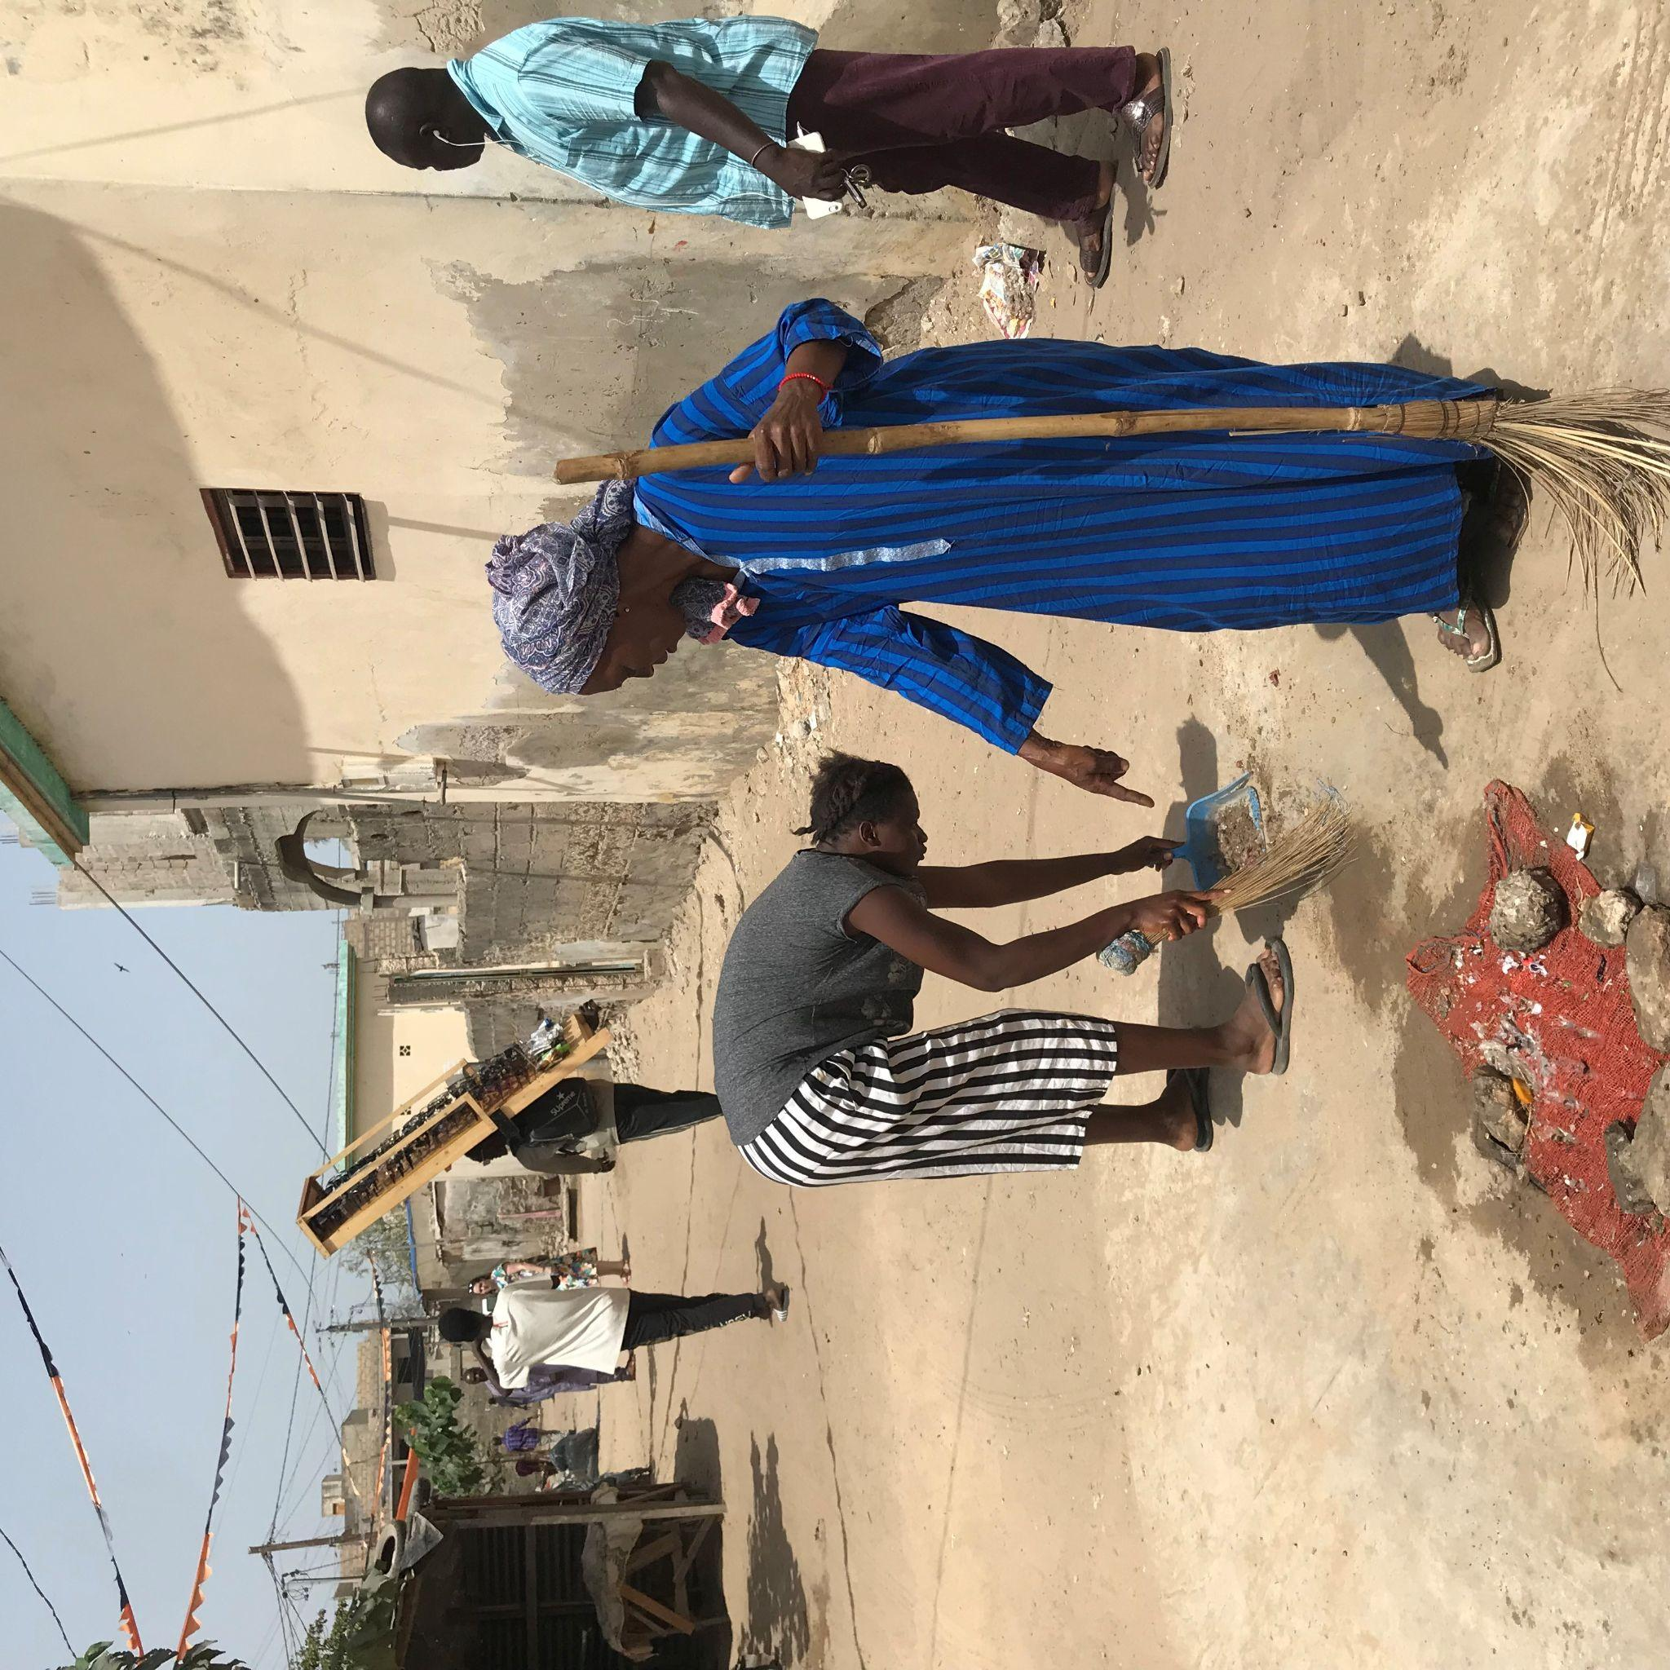
Empowering citizens - Improving local governance
This integrated flood-risk management approach has a positive impact on governance, local democracy and territorial dialogue around local issues.
Empowerment of local communities, particularly women.
Residents are stakeholders in the projects, not just beneficiaries.
The financial participation of residents motivates their contribution to the facilities’ management.
The revolving fund is a responsive tool for the co-financing of community projects by residents: easier to mobilise funding from residents than from local authorities (problem of disbursing public funds).

Slide 19
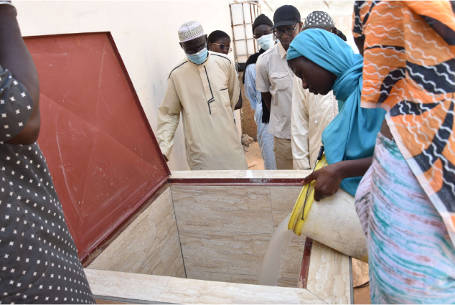
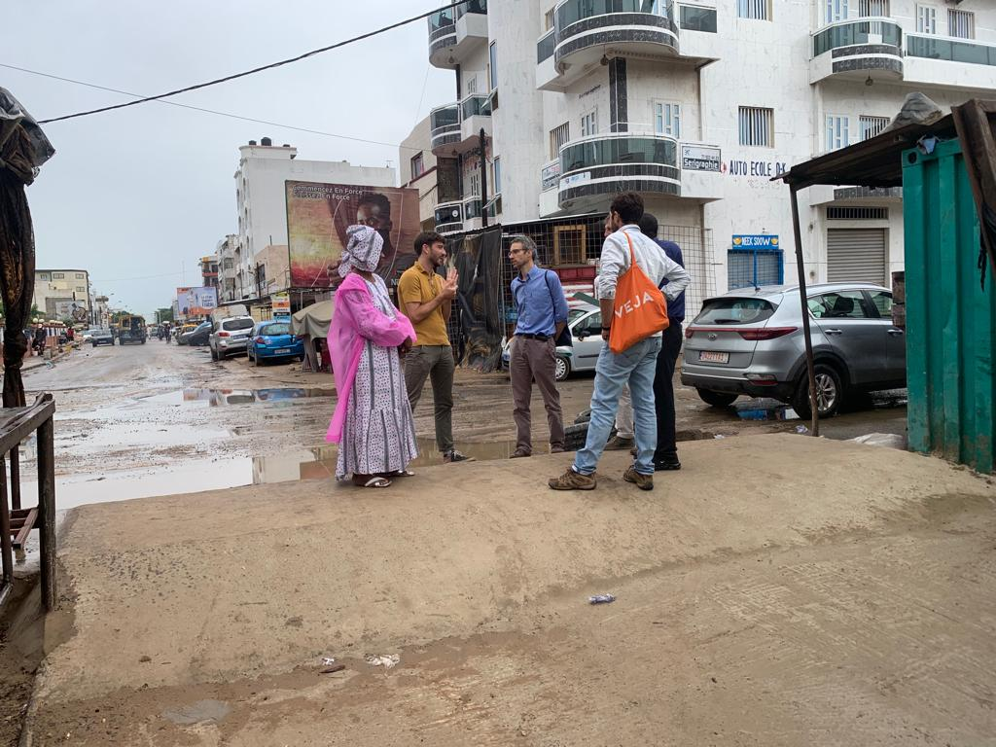
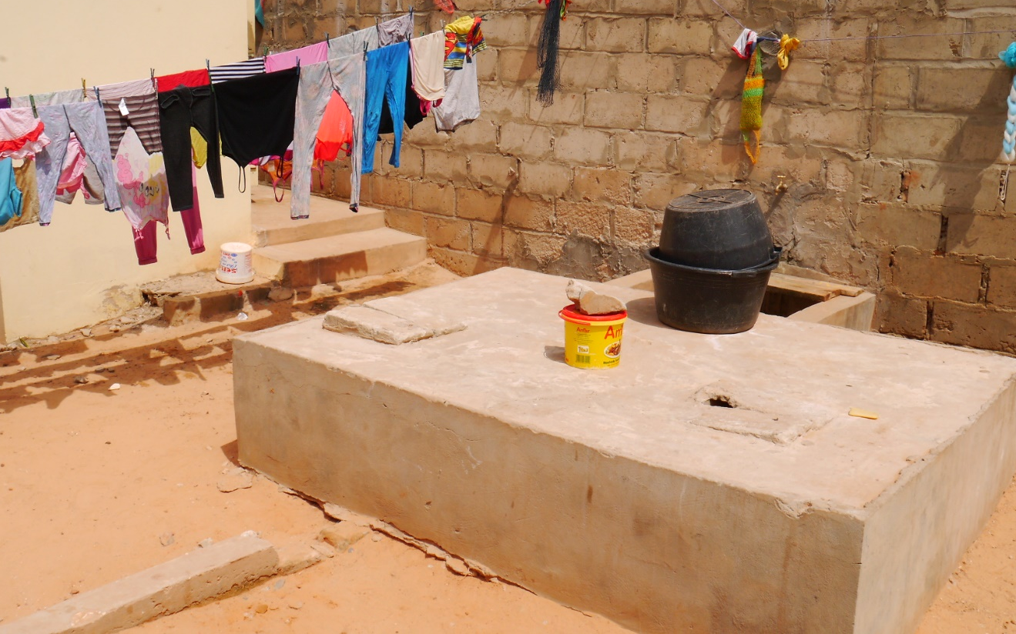
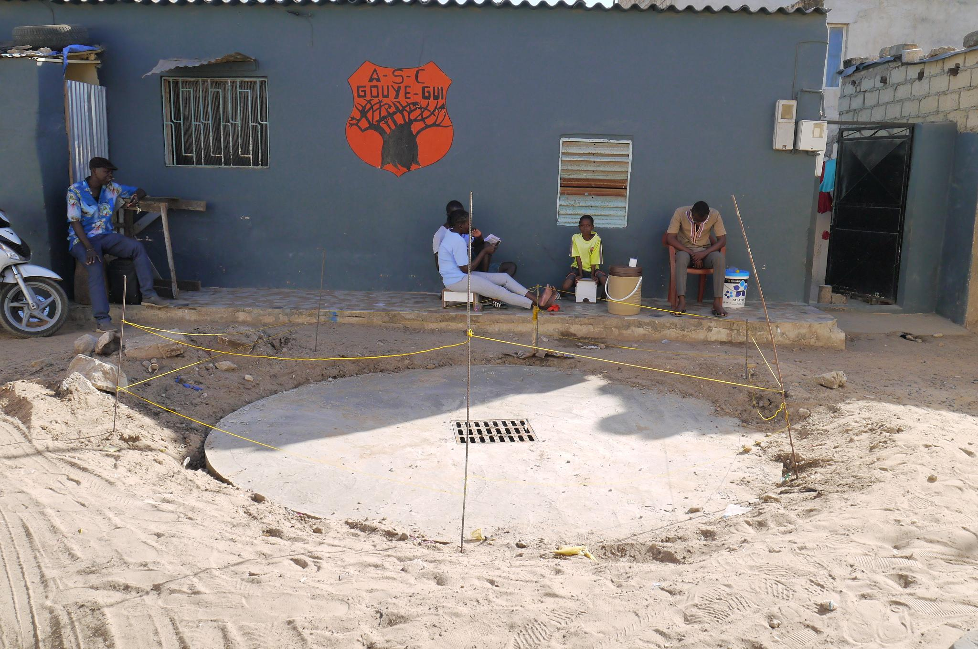
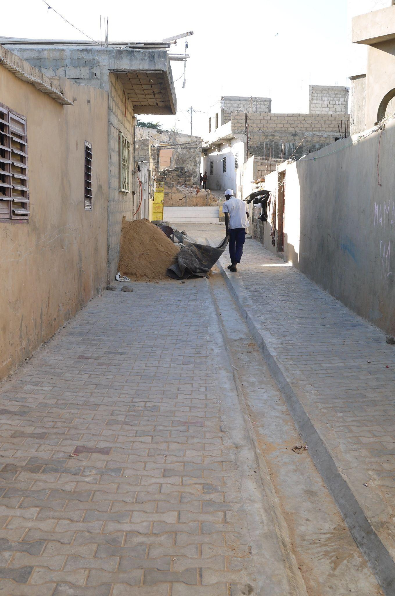
Types of facilities realized
- Street water barriers
- Conventional drainage networks
- Semi-collective sumps for waste-water
- Gutters and permeable paving
- Individual pits

Slide 20
Food for thought
Implying deprived communities in floods/natural risk management is a necessity, both for justice and efficiency.
It requires political will, and collaboration between stakeholders at different levels: organised communities, municipal authorities, public services, NGOs.
Building resilience, one brick at a time, by experimentation/test and learn approach.
Capacity-building is key, from the lowest level: inhabitants, craftsmen
This kind of approach is also an opportunity to experiment more sustainable, nature-based, low-tech, cost-efficiency solutions

Slide 21
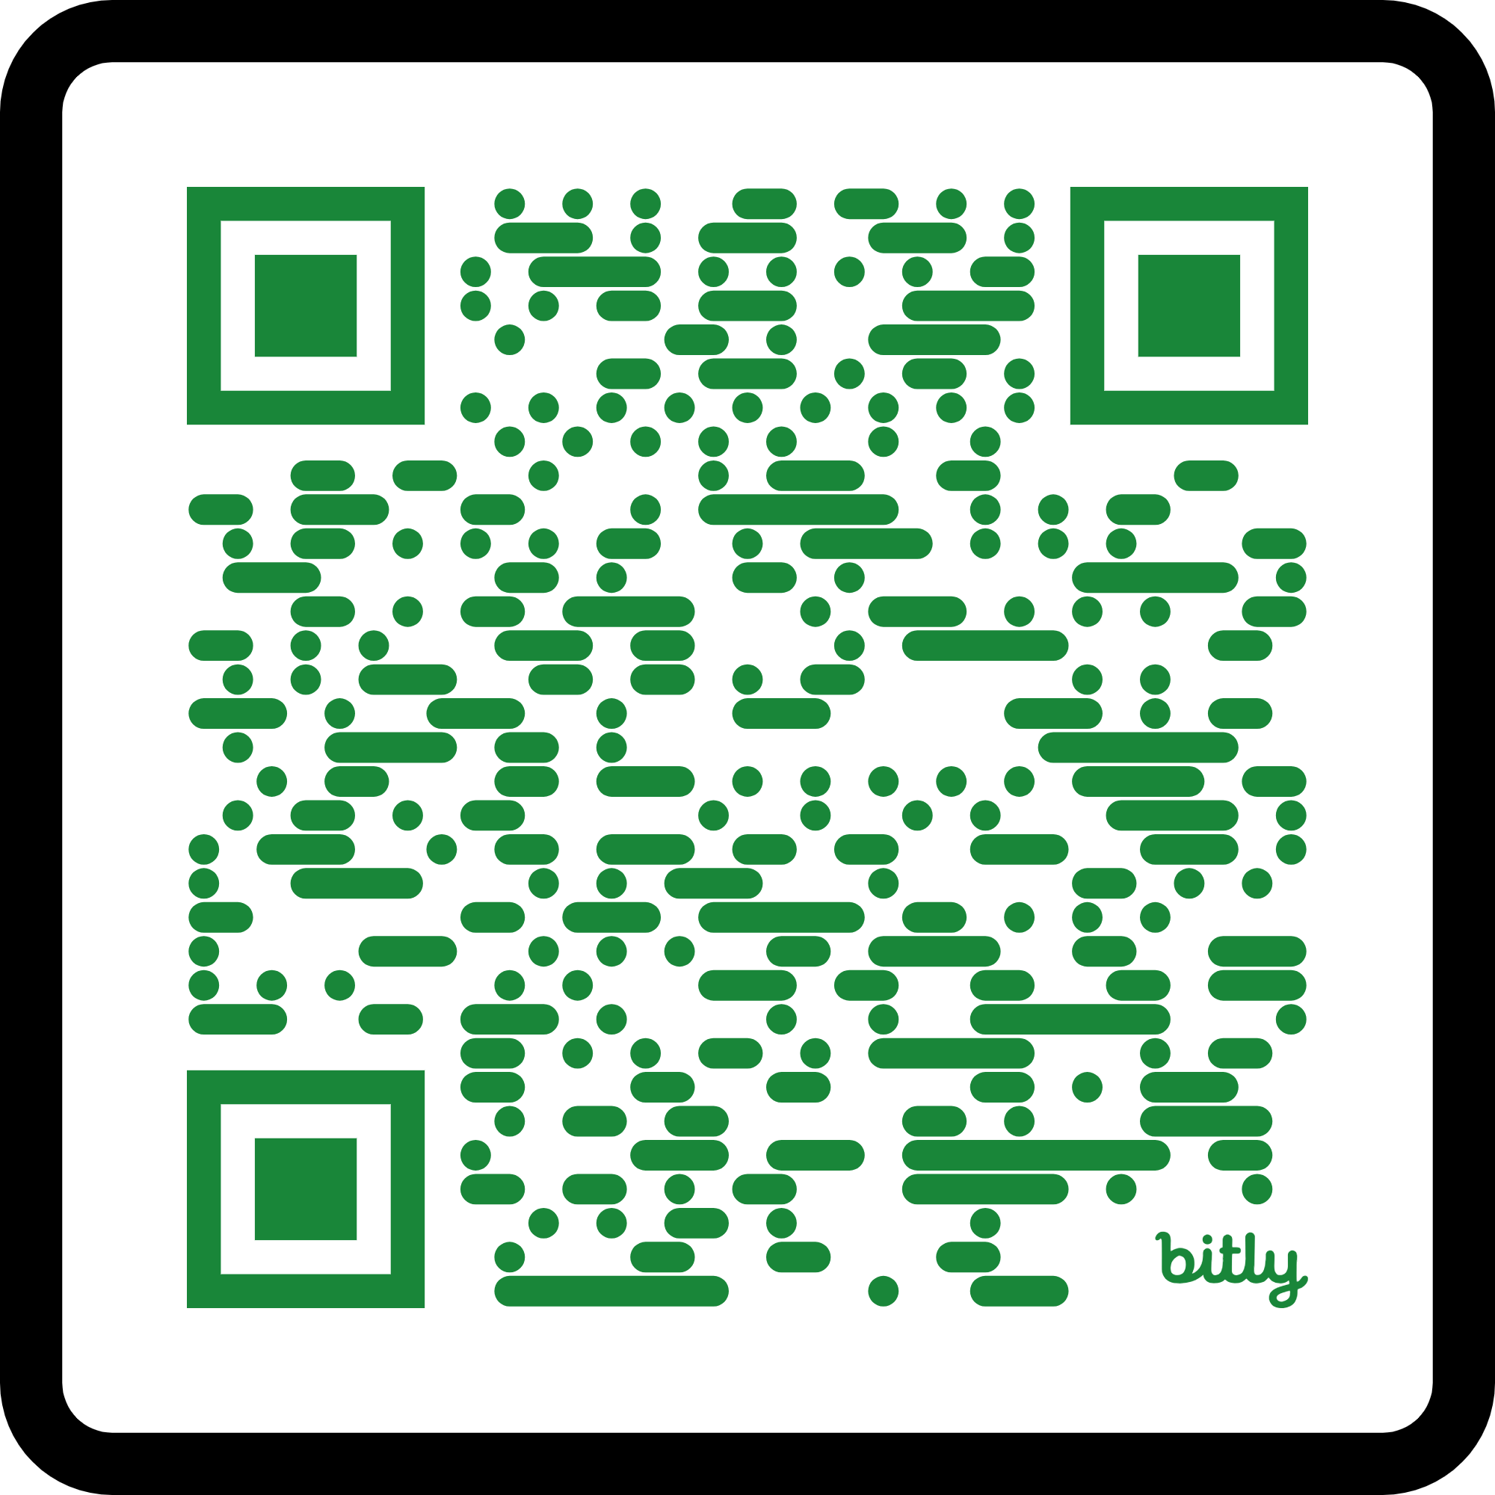
Further information...
« Mbolo moy dole / Unity is strength »
Documentary film (2019) relating the emergence of the FSH community movement that led to the flood-risk management projects in Dakar sububs.

Slide 22
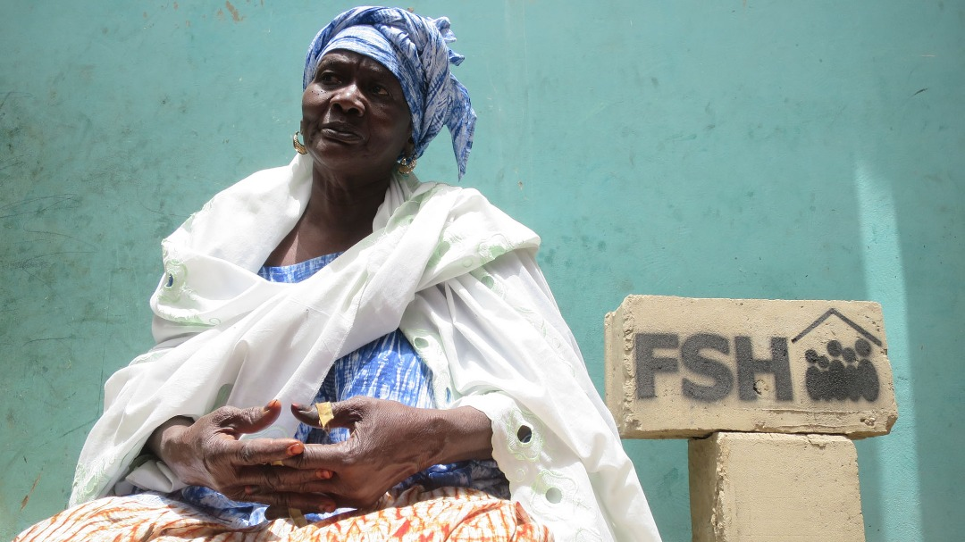
THANK YOU

