Slide 1
Housing in Europe
IUHF, Berlin 18-19 September
Public, Social, Cooperative perspective

Slide 2
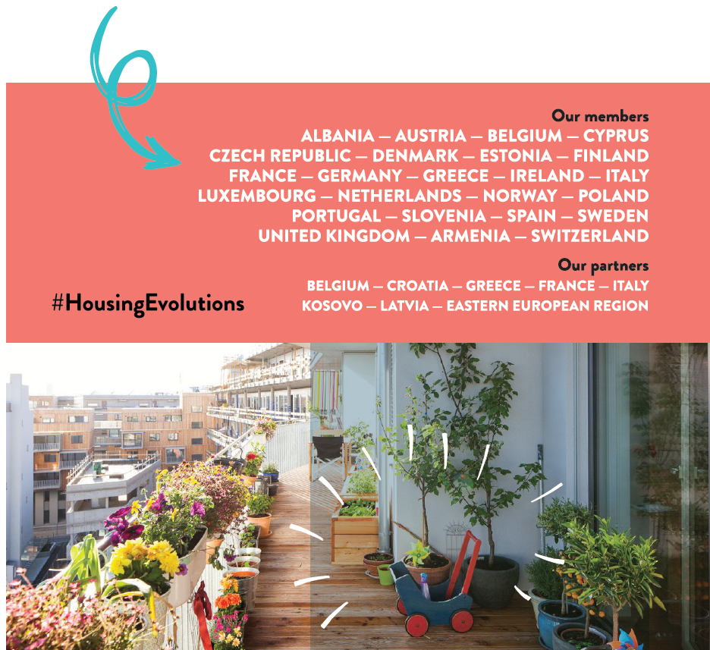
The richness of the Housing Europe Network
43,000 local housing organisations
25 countries
24,936,000 dwellings
roughly 200,000 new dwellings per year
over 200,000 dwellings refurbished per year
roughly €40bn in new investment per year
7,500+ staff employed by the federations
300,000+ staff employed by local providers
One goal To provide decent & affordable housing for all

Slide 3
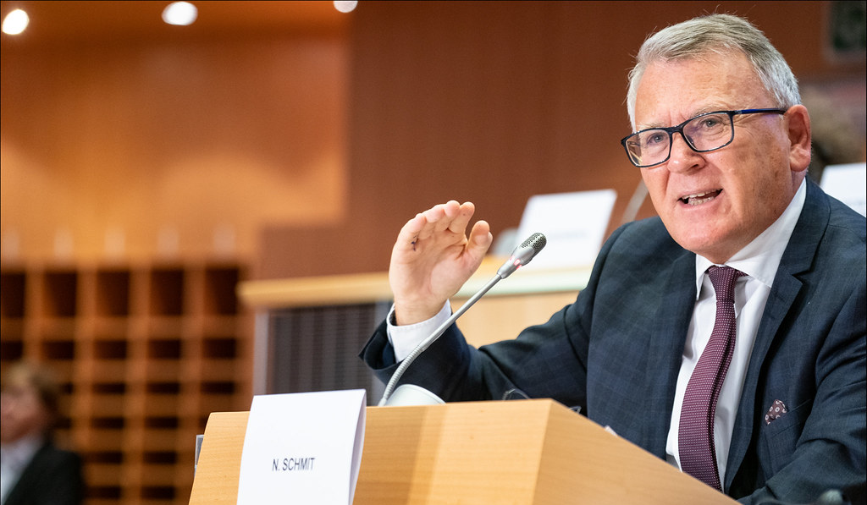
Call to housing policymakers to stick together
Copyright: CC-BY-4.0: © European Union
NICOLAS SCHMIT
COMMISSIONER FOR JOBS & SOCIAL RIGHTS
“Housing is a European problem with national and local solutions.
The EU can help to put together all the actors and have good exchanges of views and practices, to have a positive dynamic.”

Slide 4
New European Affordable Housing Plan
What will come next after?
Housing is tearing our societies apart – Can an EU plan help close the inequalities ? ....
Pan-European Housing Finance Platform – ‘More speculative extractive financing or generation of social value ? Revolving funds, affordability in perpetuity, good governance, limited profit

Slide 5
Thank you
Stay connected!
Twitter | Facebook | LinkedIn
@HousingEurope

