Slide 1
HOUSING CONSTRUCTION SAVINGS SYSTEM IN THE REPUBLIC OF KAZAKHSTAN
L. Ibragimova
September, 2024

Slide 2
HOUSING CONSTRUCTION SAVINGS SYSTEM IN THE REPUBLIC OF KAZAKHSTAN
JSC "OTBASY BANK":
Act of the Republic of Kazakhstan:
"About housing construction savings in the Republic of Kazakhstan":
Otbasy bank is the only representative of housing construction savings (HSC) market in Kazakhstan;
Bank operates according to principles of German HCS model since 2003;
The sole shareholder – JSC “National managing holding "Baiterek" since 2013. The Bank is ultimately controlled by the Government of the Republic of Kazakhstan;
Bank is an operator of housing construction state programs;
Acceptance of housing constructions savings (deposits), opening and maintenance of depositors’ accounts;
Granting of basic, preliminary and intermediate housing loans to depositors for improvement of their living conditions.
Does not limit market entry of HSC banks by proprietary form;
Guarantees state premium to depositors (20% of deposit but not more than 200 MCIs) regardless to the FI ownership form;
Limits spread between housing loan interest and housing construction savings deposit interest - 3%.
BENEFITS:
Wide spread network of branch and agent within the country;
State participation in Banks’ equity;
High quality of loan portfolio;
Low loan interest rates;
Tax incentives.

Slide 3
HOUSING CONSTRUCTION SAVINGS SYSTEM IN THE REPUBLIC OF KAZAKHSTAN
HOUSING CONSTRUCTION SAVINGS SYSTEM
HOUSING LOAN
2% p.a.
Deposit interest rate
Annual state premium
From 2%
to 5% p.a.
+20%
DEPOSITORS
Monthly contributions
BANK
Granting of housing loan
HCS SYSTEM PARTICIPANTS
50%
BANK
Interest accrual
50%
SAVING
LOAN
DEPOSITORS
Repayment of housing loan
GOVERNMENT
Annual premium
3-15 YEARS
6 MONTH - 25 YEARS

Slide 4
OTBASY BANK – SUMMARY
Mission: Strengthening the sense of Homeland by providing families with their own homes, enhancing LT well-being.
Vision: We, Otbasy Bank, are a reliable and steadily developing system of savings and financing for the population and companies, including state social programs.
Goals:
Enter the TOP-2 banks in Kazakhstan by assets;
Leader in market share of LT savings and mortgage market;
Best employer in the KZ banking market.
1
Mission and Strategic Goals (for 2024-2033)
2
Geography and Network:
1,487 employees
20 branches
17 service centers
29% share of HCS system participants among the economically active population (EAP) of Kazakhstan
54% share in mortgages among banks
The lowest level of NPL (non-performing loans) among banks (0.10%)
Market Share and Positions
Ratings:
Moody’s: Baa2 (Positive)
Fitch Ratings: BBB (Stable)
3
Assets: €8 112 million
Loan portfolio: €3 197 million
Deposit portfolio: €6 262 million
Number of loans granted : 537 thousand
Number of clients: 2,7 million clients
Mortgage Lending Indicators:
Volume of loans granted (2023): €2 126 million
Number of purchase and sale transactions (January-July 2024): 224 thousand
Key Indicators
(as of August 1, 2024):

Slide 5
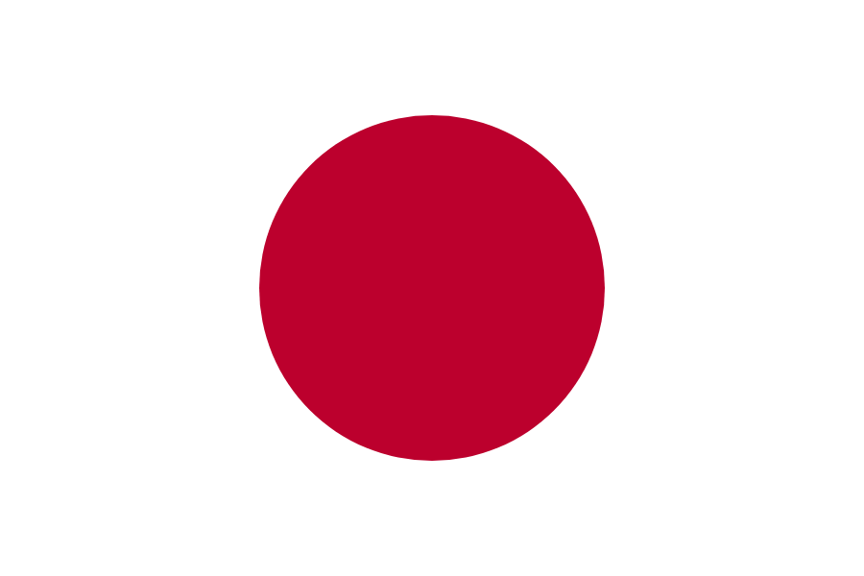
ASSESSMENT OF INTERNAL AND EXTERNAL CONDITIONS HOUSING AVAILABILITY REMAINS LOW
The Bank has fundamental advantages and is supported by growing macro indicators of the Republic of Kazakhstan
TOTAL AREA OF COMMISSIONED HOUSING, mln. m²
In 2023, the volume of housing commissioning increased 3.5 times compared to 2005. Starting from 2020, the annual volume of housing commissioning is at the level of 15-17.5 million m², due to the active growth of state housing programs.
Financial strength: Five-fold growth in net income over the last 4 years.
Brand Recognition: Unique housing savings products with the state premium.
Advanced digital solutions: a wide range of digital services including: property registration using blockchain technology, a unique scoring model and a proprietary aggregator for house buying.
110-160
thousand
ACCOMMODATION PER INHABITANT (m² per person)
UN standards
new families per year will increase demand through the 2030s
23,9
30
35
39
47
68
76

Slide 6
ASSESSMENT OF INTERNAL AND EXTERNAL CONDITIONS HOUSING PRICES, MORTGAGE INTEREST RATES
Share of mortgage to GDP, %
Interest rate on mortgages granted by the banking sector, in local currency, %
Otbasy bank’s mortgage interest rates:
from 3,5% to 5% p.a.- housing loans;
from 6% to 10% p.a. - intermediate loans;
from 5% to 14.4% p.a.- preliminary loans.
Otbasy bank's mortgage interest rate within governmental programs:
from 2% to 5% p.a.
Mortgage interest rates (excluding partner programs) in other banks:
from 14% to 21% p.a.

Slide 7
OUR MARKET ACHIEVEMENTS WITHIN THE
DEVELOPMENT STRATEGY FOR 2014-2023
2014
2023
the 1st place in the long-term deposit market
5,3% of the economically active population are served by Otbasy bank
21% Otbasy bank’s mortgage share among banks and mortgage companies
0,64% NPL is the lowest among banks of Kazakhstan
the 7th place on equity among banks of Kazakhstan
the 10th place on assets among banks of Kazakhstan
€1,1 bln deposit portfolio
€0,9 bln loan portfolio
ROA – 2,97%, ROE – 11,28%
the 2st place in the long-term deposit market
29% of the economically active population are served by Otbasy bank
55% Otbasy bank’s mortgage share among banks and mortgage companies
0,08% NPL is the lowest among banks of Kazakhstan
the 4th place on equity among banks of Kazakhstan
the 4th place on assets among banks of Kazakhstan
€4,7 bln deposit portfolio
€6,4 bln loan portfolio
ROA – 3,97%, ROE – 27,90%
For the entire period of the Bank's operations:
Dividends paid to the Sole Shareholder in the amount of €412 million;
The maximum net profit earned by the Bank for 2023 is €294 million.

Slide 8
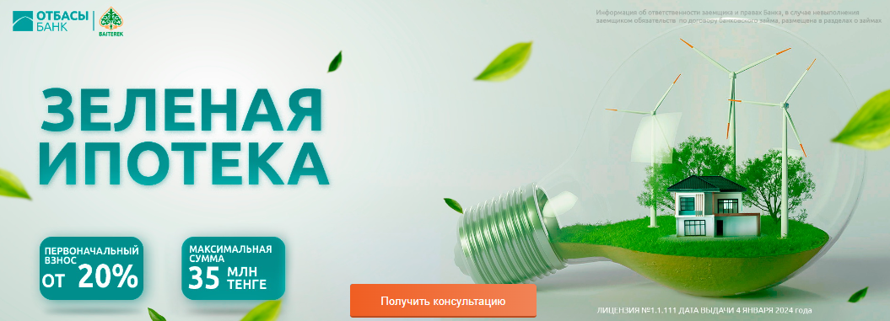
IMPLEMENTATION OF OTBASY BANK’S PROGRAMS
Sources of project funding:
Republican budget, local budgets, National Fund, ADB and Bank’s own funds
PROGRAMS FOR CITIZENS IN THE WAITING LIST
BANK’S MARKET PROGRAMS
REGIONAL AND CORPORATE PROGRAMS
RENTAL SUBSIDY
WOMEN'S MORTGAGE
GREEN MORTGAGE
NATIONAL FUND FOR CHILDREN
MILITARY PROGRAM
YOUTH MORTGAGE
RURAL MORTGAGE
EDUCATIONAL DEPOSITS/LOANS

Slide 9
GOVERNMENT SUPPORT AND CONFIDENCE
Over the entire period of the Bank's activity, the Bank attracted budgetary funds of about €2 billion within the framework of state and regional programs.
As of the end of 2023, the share of loans granted within market programs in the loan portfolio is 78% and within governmental programs is 22%.
State premium of €856 million credited to depositors' accounts.
More than 1 million clients have used unified pension payments for housing improvement and medical treatment.
A total of €11,5 million has been paid from budgets for rental subsidies over the years 2022-2023: republican budget – €9,3 million, local executive bodies – €2,2 million.

Slide 10
ESG-PERFORMANCE INDICATORS
Е
S
G
Environmental performance of activities
Social
performance of activities
Corporate governance
€25 mln.
granted to 492 clients for green mortgage
17
partners-construction companies on green mortgage
33%
share of social loans in IP (93 086 loans worth €2,1 billion)
385
persons with disabilities supported by the
€10 mln.
3,7
thousands of women supported at €82 mln. on "Umay"
96%
compliance level of corporate governance best world practice, rating «Adequate»
0
cases of litigation relating to confidentiality of clients
28%
reduction in electricity consumption
12%
reduction of water consumption
€35 mln.
granted
3 416 clients for program "With a diploma to the village"
€11,5 mln.
10 444 citizens paid rental subsidy
79%
level of employee engagement
86%
Bank’s Confidence Index
0
cases of corruption; conflict of interest
41% -
share of male depositors
59% -
share of female depositors
GRI, SASB
standards disclosure
Accounting for GHG emissions
305 tones of direct CO2 emissions
(coverage 1);
5 808 tones of indirect CO2 emissions
(coverage 2).
12
persons with disabilities
0
complaints against employer; discrimination; injuries

