Slide 1


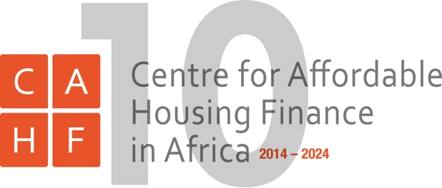
Regional developments in housing finance in Africa
Johnstone Oltetia
Director AUHF & CEO KMRC
CAHF is the Secretariat to the AUHF
INTERNATIONAL UNION FOR HOUSING FINANCE WORLD CONGRESS
BERLIN, GERMANY
18-19 SEPTEMBER 2024

Slide 2
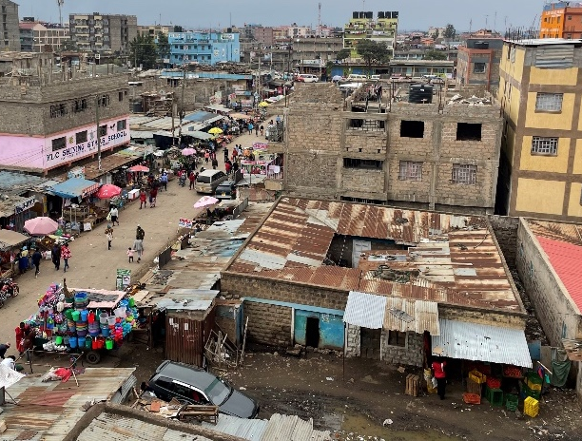
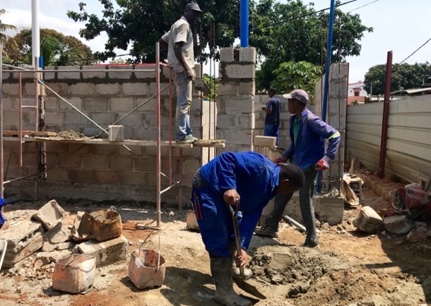

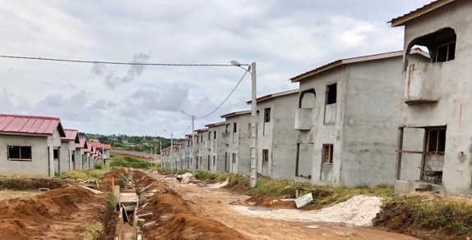
Cities are built the way they are financed – Bertrand Renaud, 1984 and are being built, every day, across Africa, by households and builders that conventional lenders don’t recognise and that their loan products don’t target. How can we change this dynamic?
Financial markets play a critical role in shaping patterns and creating opportunities for housing investment, enabling access to affordable housing and explicitly improving household living conditions. Housing-targeted finance products engage with the housing delivery and home improvement process, stimulating demand and enabling supply. At the same time, the housing sector creates opportunities for financial intermediation all the way up the finance value chain, strengthening the financial sector and enabling financial sector stability. When financial markets don’t work for housing, the whole economy suffers as poor living environments make for poor working and earning environments.
Nairobi, Kenya
Maputo, Mozambique
Democratic Republic of the Congo
Abidjan, Côte d’Ivoire

Slide 3
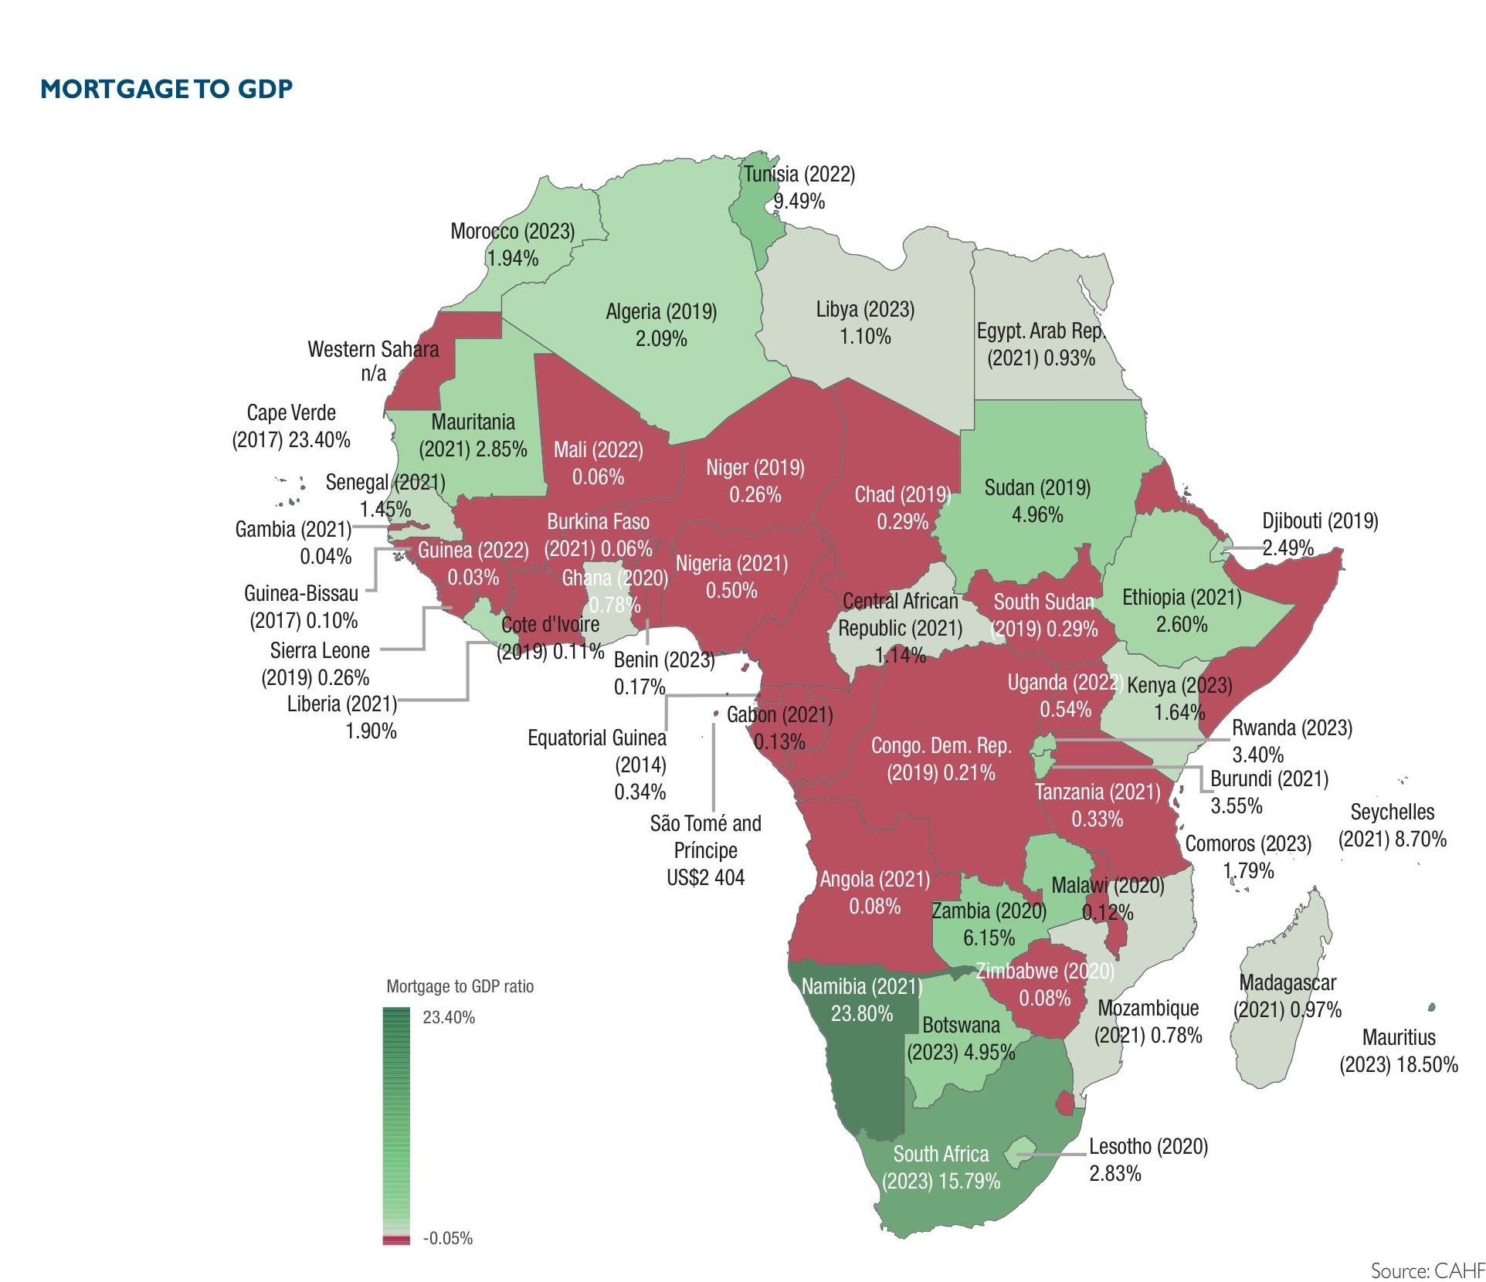
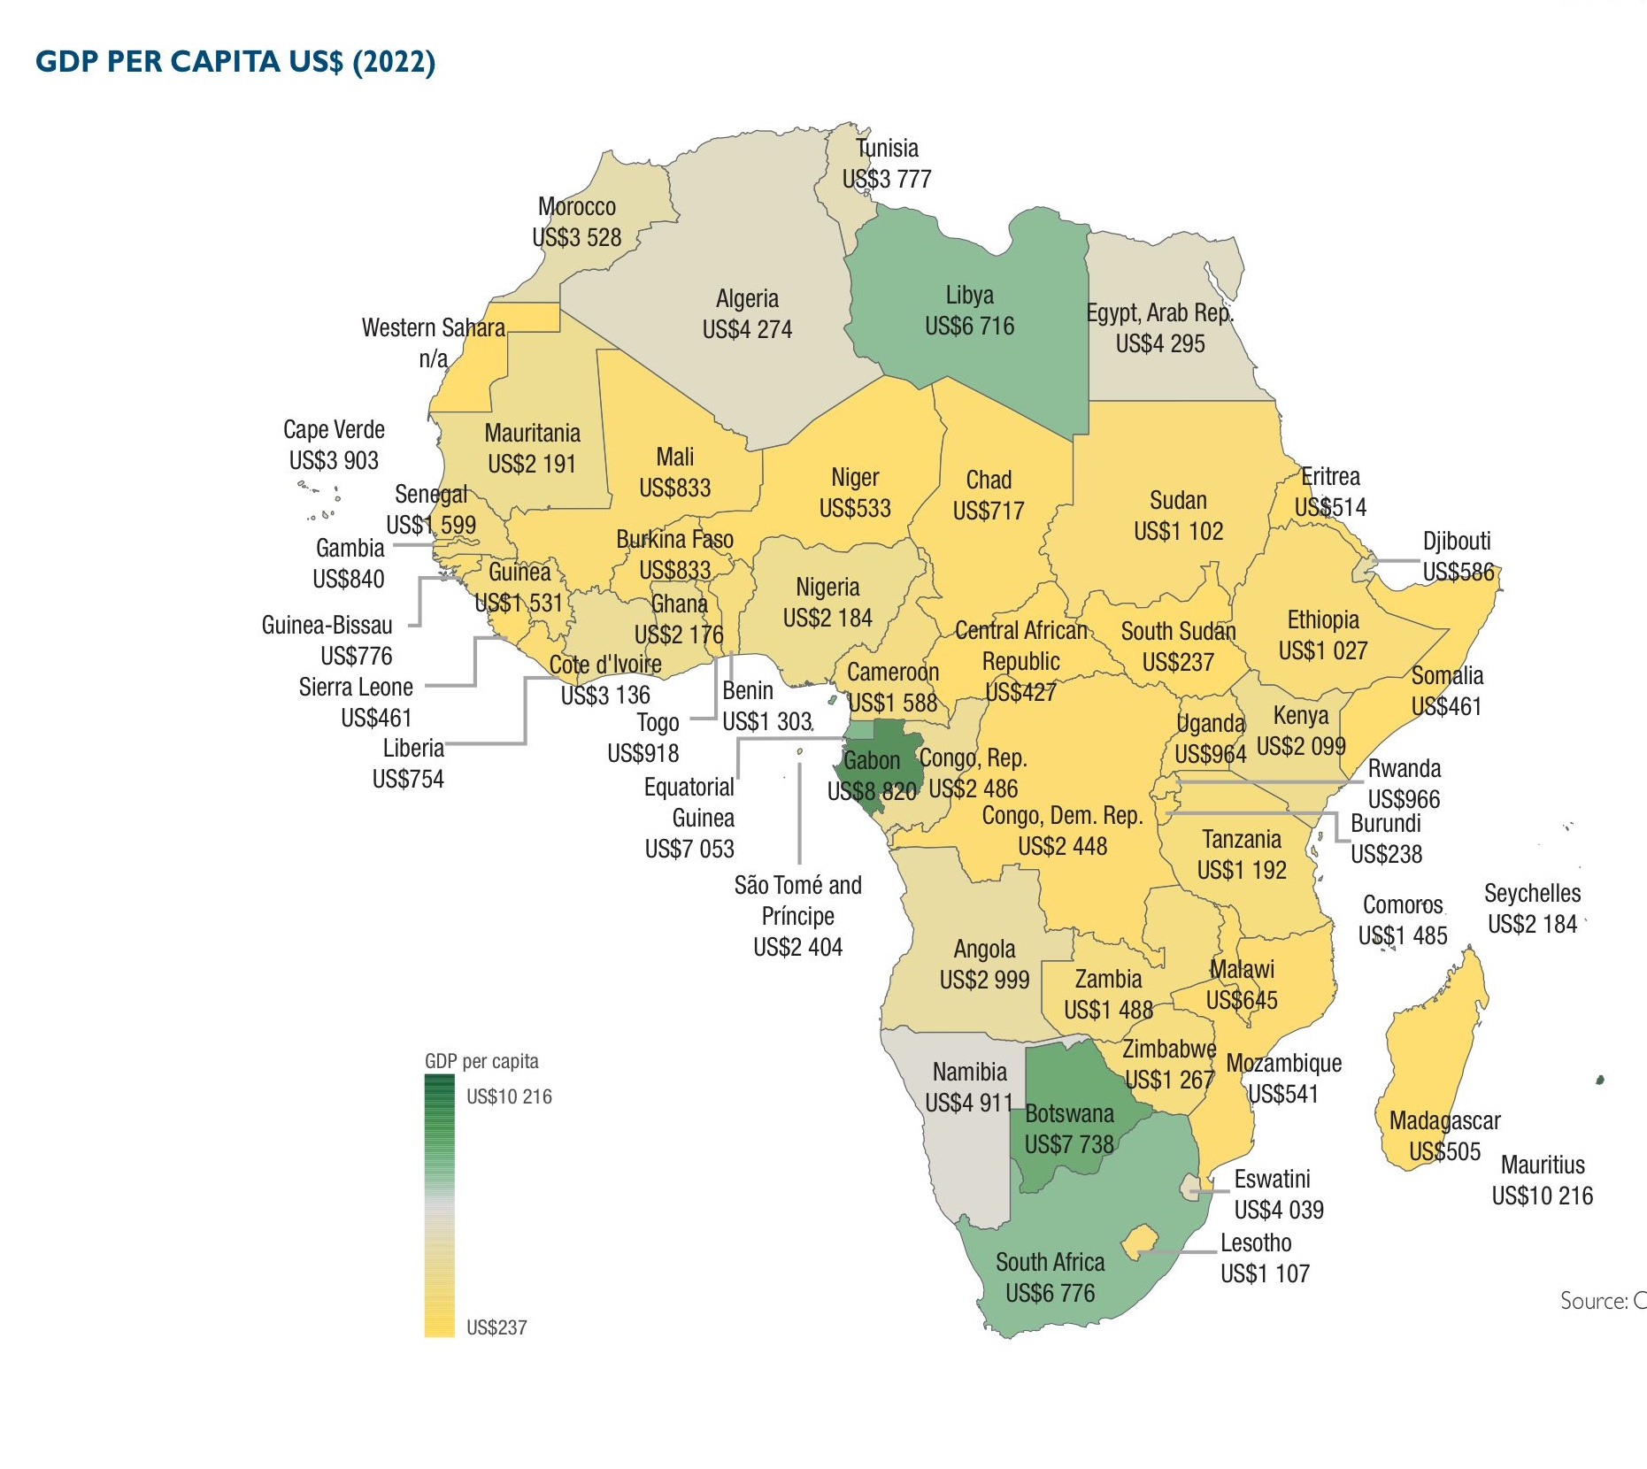
African lenders face particular challenges: incomes are low, irregular and informal; and most potential borrowers are first time home owners. Formal title is not always available. Most housing is built incrementally, by households themselves. Mortgage finance is not the way households finance their homes.

Slide 4
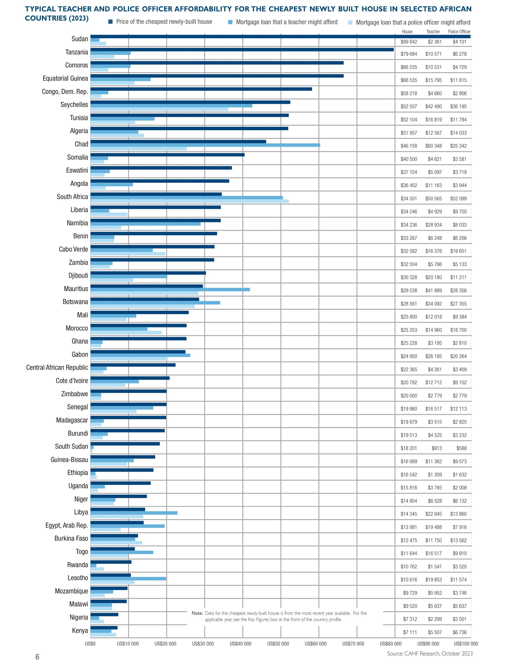
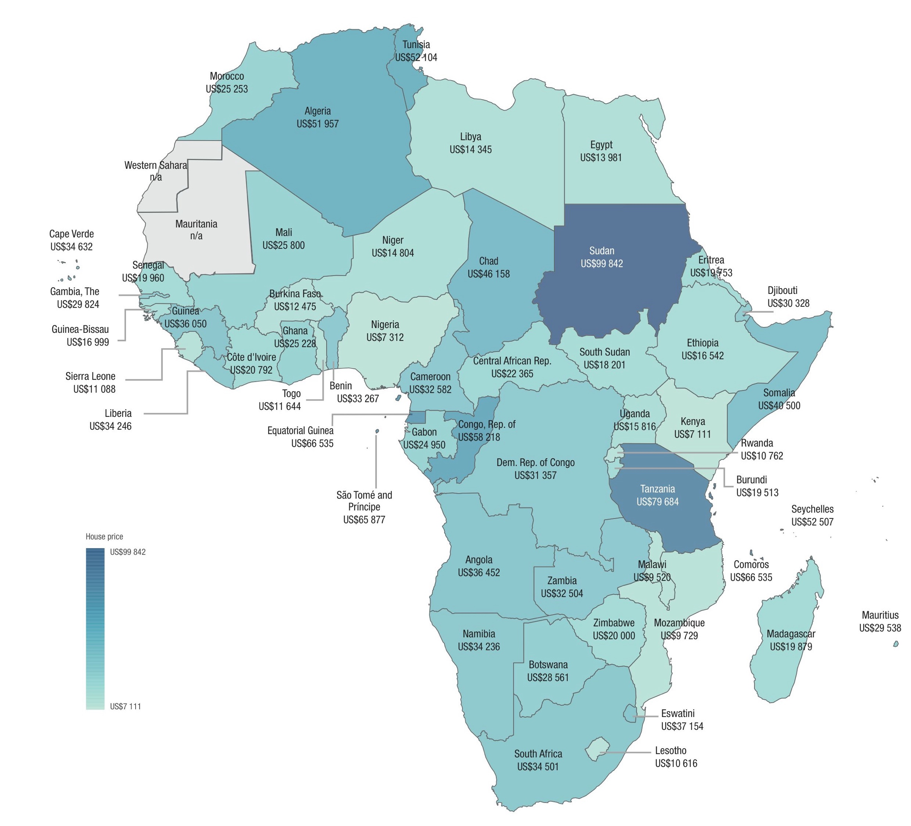
The formal market is not delivering to the population. Across Africa in each country, in 2023, the cheapest house, built by a formal developer in an urban area was generally not affordable to key public sector workers – even in
Kenya
https://housingfinanceafrica.org/resources/yearbook/

Slide 5

As mortgage lenders, we require evidence of income. But this is typically only available for those in formal employment – for example, in Uganda:
Of the almost 4 million earners in Uganda, less than 25% are in the formal sector. Most private sector workers are in the informal sector. Even more workers are simply employed by a private household.
Analysis by
Notes:
Internal\Projects\Africa Incomes Data Hunt\Analysis\Uganda\unps_sec8_labour_2019\unps_hh_section8_labour_2019_2020.xlsx

Slide 6
…and then the situation changes so rapidly, that survey data cannot be sufficient for shaping understanding
“It should however, be noted that 80 percent of those in self-employment in 2013/14 were still self-employed, 10 percent were no longer working in 2018/19 and 10 percent joined paid employment during the same period. In addition, 65 percent of the persons in paid employment during in 2013/14 were still in paid employment in 2018/19, 29 percent became self-employed and six percent were no longer working.
– UGANDA NATIONAL PANEL SURVEY 2018/2019, WAVE VII REPORT

Slide 7
Formal, large- and small-scale developers are in the minority. For example, in Rwanda. But we all still see this as an anomaly.
99% of households in Rwanda live in housing that was delivered either by themselves or by small scale suppliers
https://housingfinanceafrica.org/projects/scoping-rwandas-affordable-housing-sector-and-its-financing/
Only 2% of urban households accessed their housing from a formal developer

Slide 8
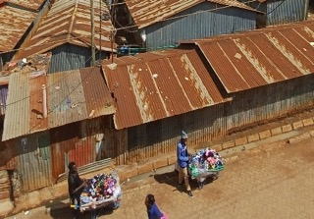
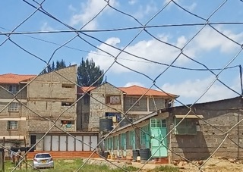
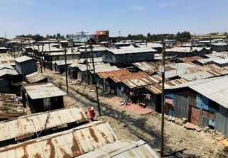
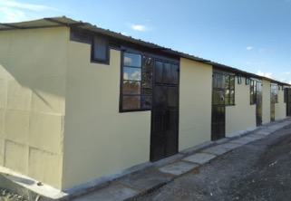
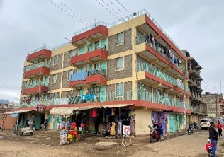
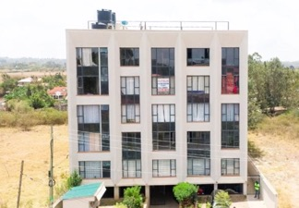
In Kenya, 78% of urban households rent their primary dwelling, but only 17% of these live in so-called “formal rental”. The majority rent from individuals. How can lenders enable this activity in support of better quality?
Urban Kenyan renter household segments (number of households; % of urban households)
Segmented based on area type* & housing quality
Segment 1
Segment 2
Segment 3
Segment 4
Segment 5
Segment 6
​ Informal area, non-durable materials | Informal area, durable materials​ | ​ Formal area, non-durable materials | Formal area, durable materials, non-flush sanitation​ | Formal area, durable materials, flush toilet shared​ | ​ Formal area, durable materials, flush toilet not shared​
Source: Census 2019. Note: *Area type defined as formal and informal as per the data provided in the Census 2019
Segment size
(6%)
(3%)
(16%)
(17%)
(31%)
(26%)
Landlord
Private individuals, likely live-in landlords with similar socio-economic background as the tenants
Private individuals, may be live-in or absent landlords, who have access to land through inheritance or marriage, or who are renting out space / dwellings they have in public housing estates
Private individuals or small-scale developers (companies), more likely to be absent landlords – have accessed land through inheritance or marriage, or purchased land and built or renovated an existing building
https://housingfinanceafrica.org/documents/positioning-affordable-and-backyard-rental-housing-as-a-key-target-in-kenyas-affordable-housing-programme-draft-findings/

Slide 9
African housing lenders need to get their heads around these challenges and embrace the opportunities for:
Incomes are low & informal
… new loan products that better accommodate informal earners
Borrowers are new to credit
… new underwriting standards and systems to manage risk
Access to formal title is limited
… non-mortgage credit, recognition of alternative forms of tenure
Most housing is built by households
… new loan products that support quality & enable incremental build
Formal developers lack capacity
… specialist housing construction lending
Governments are cash-strapped
… new PPP arrangements that enable investment & facilitate building
Investors are wary
… targeted data collection and risk management interventions

Slide 10
Some examples from AUHF members: engaging with the demand side
Underwriting for informal incomes and alternative credit scoring
Kenya Mortgage Refinance Company is working with Syntellect in Kenya to leverage technology in building predictive models for borrower risk https://www.auhf.co.za/kenya-mortgage-refinance-company/
Installment sale as a risk management mechanism
Empowa is promoting installment sale in Mozambique by offering informal borrowers a technology-enabled payment solution https://www.auhf.co.za/empowa/
Altair has been promoting installment sale for years across the continent, most recently in Nigeria and Tanzania https://www.auhf.co.za/altair-international/
Special housing loan for rural borrowers without title
First National Bank eSwatini has developed a product for borrowers with rural / tribal tenure. It functions like a mortgage but applies in areas where there is no legal title. https://www.auhf.co.za/wp-content/uploads/2023/11/Umkhaya_-Lending-without-title-by-Nkosingiphile-Mkhonta.pdf
Loans for incremental housing purposes
Zambia National Building Society is exploring opportunities with Development Workshop Zambia to offer loans to households in site & service schemes http://www.auhf.co.za/zambia-national-building-society/
Zambian Home Loans has developed a cashflow disbursement methodology for its mortgages http://www.auhf.co.za/zambian-home-loans/

Slide 11
Some examples from AUHF members: supporting the supply side
Micro mortgages for residential resale
First National Bank South Africa is targeting government subsidized housing as entry level housing supply by offering micro-mortgages (generally between $10 000 - $25 000) to borrowers to buy housing on the resale market. FNB has been supporting government in resolving South Africa’s title deeds backlog, so that these homes can be eligible for mortgage finance. https://www.auhf.co.za/first-national-bank-home-finance/
Investment in inner city rental conversions and new builds
TUHF in South Africa provides commercial mortgages to entrepreneurial, first-time and repeat landlords offering affordable housing by regenerating inner city areas, leveraging the value of existing infrastructure and location in support of affordable housing. See www.tuhf.co.za
Off-plan mortgage lending
Unity Homes in Kenya has worked with ABSA and the KMRC to develop the first off-plan mortgage to borrowers, thereby expanding the eligible pool of home buyers. The arrangement sees Unity offering its existing land equity to ABSA Bank as security against the entire development in which borrowers can then purchase property with ABSA mortgages. These mortgages are supported by the KMRC, thus involve KMRC’s concessional interest rate. By making mortgage finance available to buyers wishing to purchase off plan, ABSA Bank is widening the potential target market for Unity, while also widening the scope of households able to conceive of buying a Unity home.

Slide 12
Some examples from AUHF members: enabling working markets
Innovative PPPs
TAF Africa Global in Sierra Leone has entered into a 80/20 partnership with the government. TAF will provide 5000 affordable housing units over five years in exchange for land for the entire development. https://www.auhf.co.za/taf-africa-global-company-limited/
Shelter Afrique in Kenya provided the initial capital to Acorn to support the development of a student housing model that is now attracting private sector investment. http://www.auhf.co.za/shelter-afrique/
Data and analysis to support investment decision-making
FSD Kenya has supported CAHF to drive the Open Access Initiative, working with developers to document, analyse and share data on their experiences with affordable housing development. This data is being used to support government in improving the enabling environment for affordable housing. https://www.auhf.co.za/fsd-kenya/
Center for Affordable Housing Finance in Africa is the Secretariat to the AUHF. Supported primarily by the French Development Agency and other funders, CAHF builds the information infrastructure to enable investment in affordable housing. www.housingfinanceafrica.org

Slide 13
In 2024, the AUHF has
73 members across
23 countries
in Africa and globally
is the Secretariat of the AUHF

Slide 14

Thank you!
Please join us in Zanzibar next month and in Cairo in November
Johnstone Oltetia
Treasurer, AUHF
CEO, Kenya Mortgage Refinance Company
Email: joltetia@kmrc.co.ke
KMRC website: www.kmrc.co.ke
AUHF website: www.auhf.co.za
Conference website: www.auhfconference.com
Many thanks to CAHF for access to data and analysis – CAHF is the Secretariat to the AUHF
Notes:
African Urban Forum- The AUHF is participating in the steering committee planning the forum.
World Urban Forum- The AUHF is hoping to co-host or host an engagement session at WUF

