Slide 1
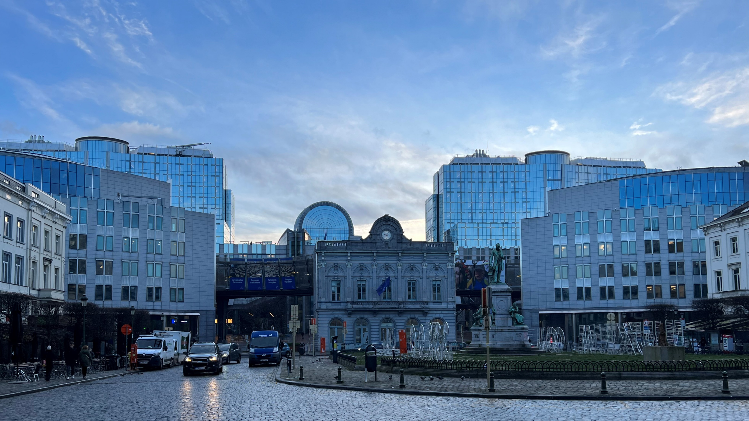
EUROPE:
Current Developments in the Housing and Housing Finance Market
Christian König, Managing Director European Federation of Building Societies
in Brussels, Belgium

Slide 2
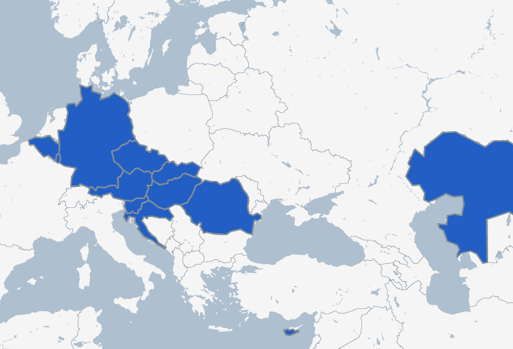
European Federation of Building Societies
Representation of credit and other institutions promoting & supporting housing finance since 1962
Currently about 50 members in the European Union and neighbouring countries
Key player in the EU legislative process for issues concerning home loans, the mortgage market and housing policy

Slide 3
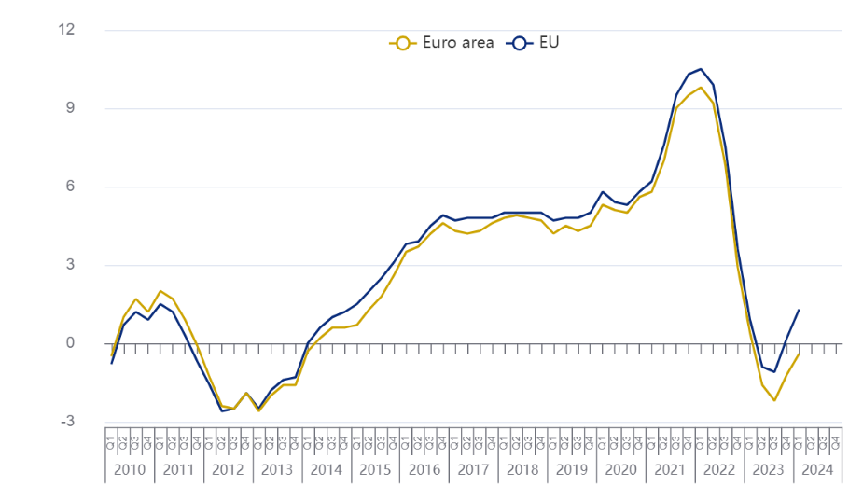
House price development in the EU: 2010-2024
Annual percent change in house prices (Q1 2024)
House prices: Annual percent change
Source: Eurostat

Slide 4
Housing market trends vary significantly in the EU
Annual percent change in house prices (Q1 2024)
Poland: + 18.0%
Bulgaria: + 16.0%
Lithuania: + 9.9%
Luxemburg: - 10.9%
Germany: - 5.7%
France: - 4.8%

Slide 5
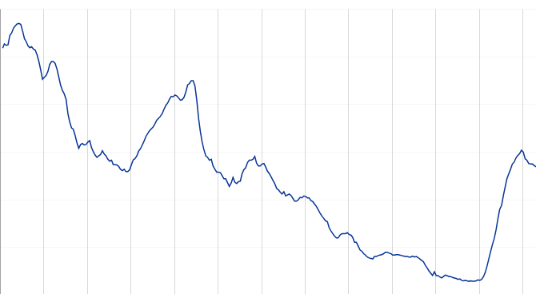
Interest rates - loans to households for house purchase
New euro-denominated loans to euro area households, interest rate in per cent
7%
6%
5%
4%
3%
2%
1%
2000 2002 2004 2006 2008 2010 2012 2014 2016 2018 2020 2022 2024
Source: ECB

Slide 6
Mortgage rates vary also in the EU
Cost of borrowing for households for house purchase in July 2024:
Estonia: 5.64%
Latvia: 5.61%
Lithuania: 5.37%
Malta: 2.29%
France: 3.40%
Belgium: 3.42%
HIGHEST RATES
LOWEST RATES

Slide 7
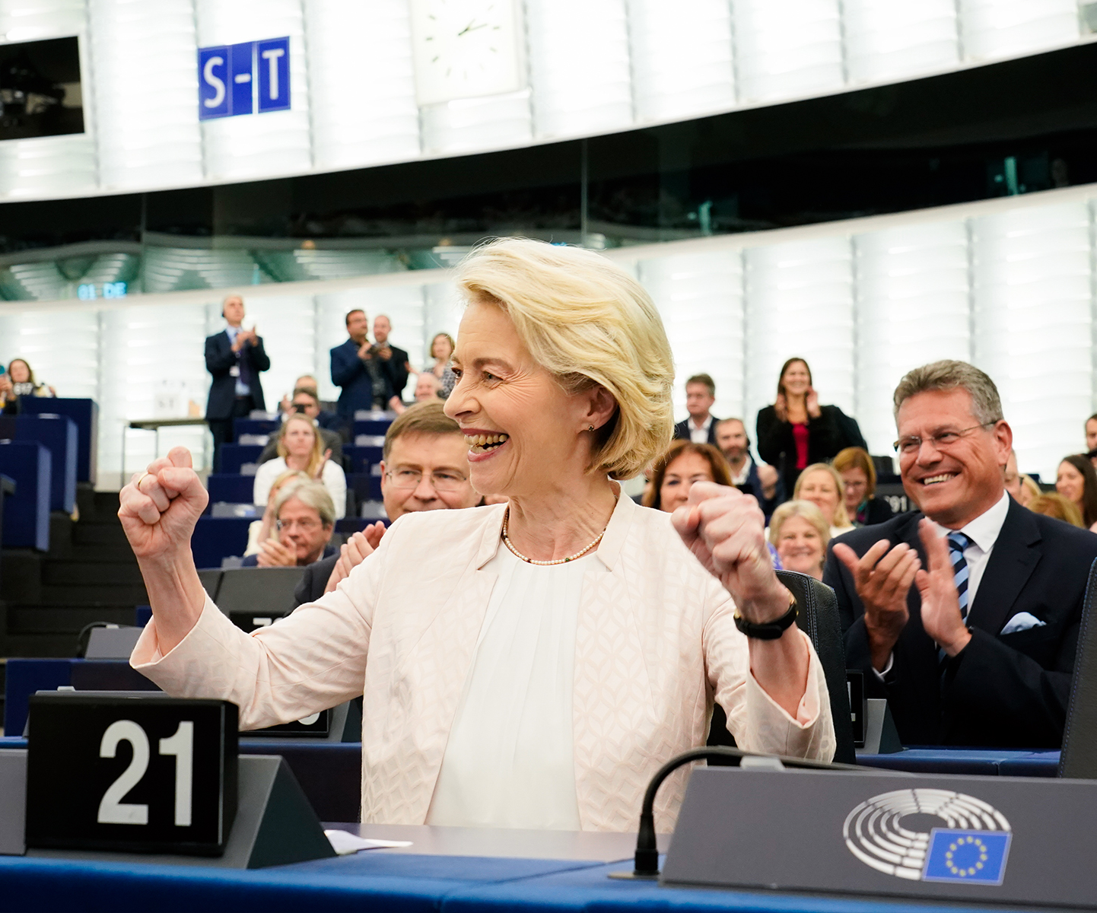
Political Agenda 2024 - 2029
Prosperous and competitive: Financing a fair, green and digital transition, bolstering our competiveness, promoting an innovation- and business-friendly environment, address demographic challenges.
Strong and secure: EU enlargement, strengthening the EU‘s security and defence and migration and border management.
Free and democratic and enhance research, innovation and education.
Source: European Union, 2024 - EP

Slide 8
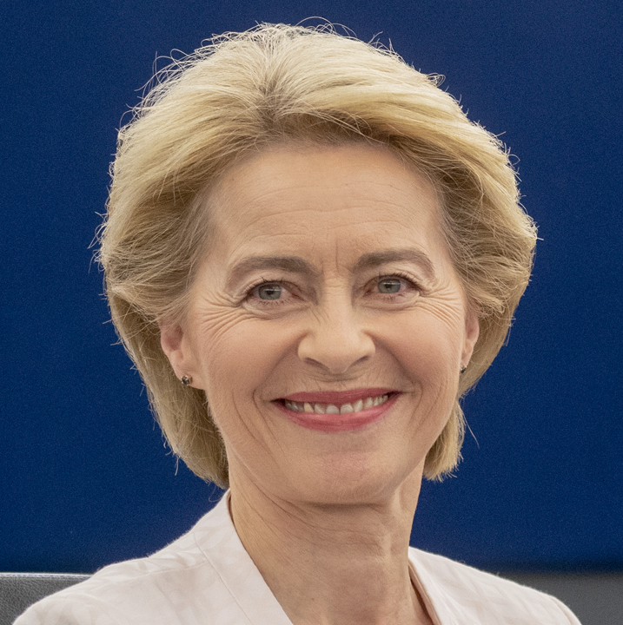
Political Agenda 2024 - 2029
Outgoing European Commission
„Von der Leyen I“
2019 until 2024
Key project: Green Deal
Focus on achieving climate neutrality by 2050 and interim target by 2030
Subject to strong electoral win for green parties in the Parliament
Incoming European Commission
„Von der Leyen II“
2024 until 2029
Key project: Clean Industrial Deal
Focus on improving European competitiveness while completing Green Deal
Subject to a shift in the Parliament toward conservative parties
Source: European Union, 2019 - EP

Slide 9
European Commission: Affordable Housing
In her candidature speech, President von der Leyen promised affordable housing as well as lower energy prices for consumers and industry
→ New EU Commissioner as well as EU task force on housing affordability
“Europe faces a housing crisis […], People are struggling to find affordable homes. This is why, for the first time, I will appoint a Commissioner with direct responsibility for housing.
We will develop a European Affordable Housing Plan, to look at all the drivers of the crisis and to help unlock the private and public investment needed.”
Source: European Union, 2019 - EP

Slide 10
European Commission: MCD
Next Commission may propose a review of the Mortgage Credit Directive (MCD)
Current version of the MCD was passed in 2014
Commission may attempt to modernise the MCD, incl. terms of consumer protection and sustainability
Possible: Introduction of a voluntary EU label for green mortgages, based on the EU Taxonomy
Source: Envoria GmbH, 2023

Slide 11
Potential Future EU Priorities
Current debates in Brussels point towards more European competitiveness
Recent guidance reports indicate possible new political priorities
Author | Christian Noyer | Enrico Letta | Mario Draghi
Publication | April 2024 | April 2024 | September 2024
Objective | Capital Markets Union (CMU) | EU Internal Market | European Competitiveness
Key points | Development of a long-term European savings product Revitalisation of the securitisation market Integrated capital market supervision | Long-term European savings product Standardised IPO access for SMEs Stronger role of ESMA for large companies | Reassessment of regulatory rules for the banking sector Harmonisation of existing regulations EU ‘securitisation platform’ to provide public guarantees for loan tranches

Slide 12
Political Outlook: Financial Markets
Creating a capital markets union
An EU product for long-term savings on an auto-enrolment basis
Further development of the European Long-Term Investment Fund (ELTIF)
Reforms of the European securitization framework
Boosting European‘s competitiveness
Harmonisation of industrial, competition and trade policy
Investments (4.4–4.7% of EU GDP)
Adaption of political structures in the EU
Completing the European single market

Slide 13
Political Outlook: Sustainability
Pending:
Finalisation of the Green Claims Directive
Regulates environmental marketing claims
Development of “ecodesign” standards
Sets requirements for many product groups on EU market
Could ban the sale of oil and gas heating systems in future
Potentially:
Further development of the EU taxonomy to promote transition activities
EU label for green loans and mortgages
Possibly as part of the next Mortgage Credit Directive

Slide 14
Contact: info@efbs-bausparkassen.org
www.efbs.org

